Slide 1

Università di Pisa
Scuola di Ingegneria
Master’s Degree in
Robotics and Automation Engineering
Academic Year
2020/2021
GUIDANCE AND NAVIGATION SYSTEMS
PROJECT WORK:
SENSOR FUSION OF AHRS, GPS,
UWB, COMPUTER VISION,
BAROMETER AND ALTIMETER
FOR AN OUTDOOR-INDOOR UAV
Student: Davide De Benedittis Professor: Lorenzo Pollini

Slide 2
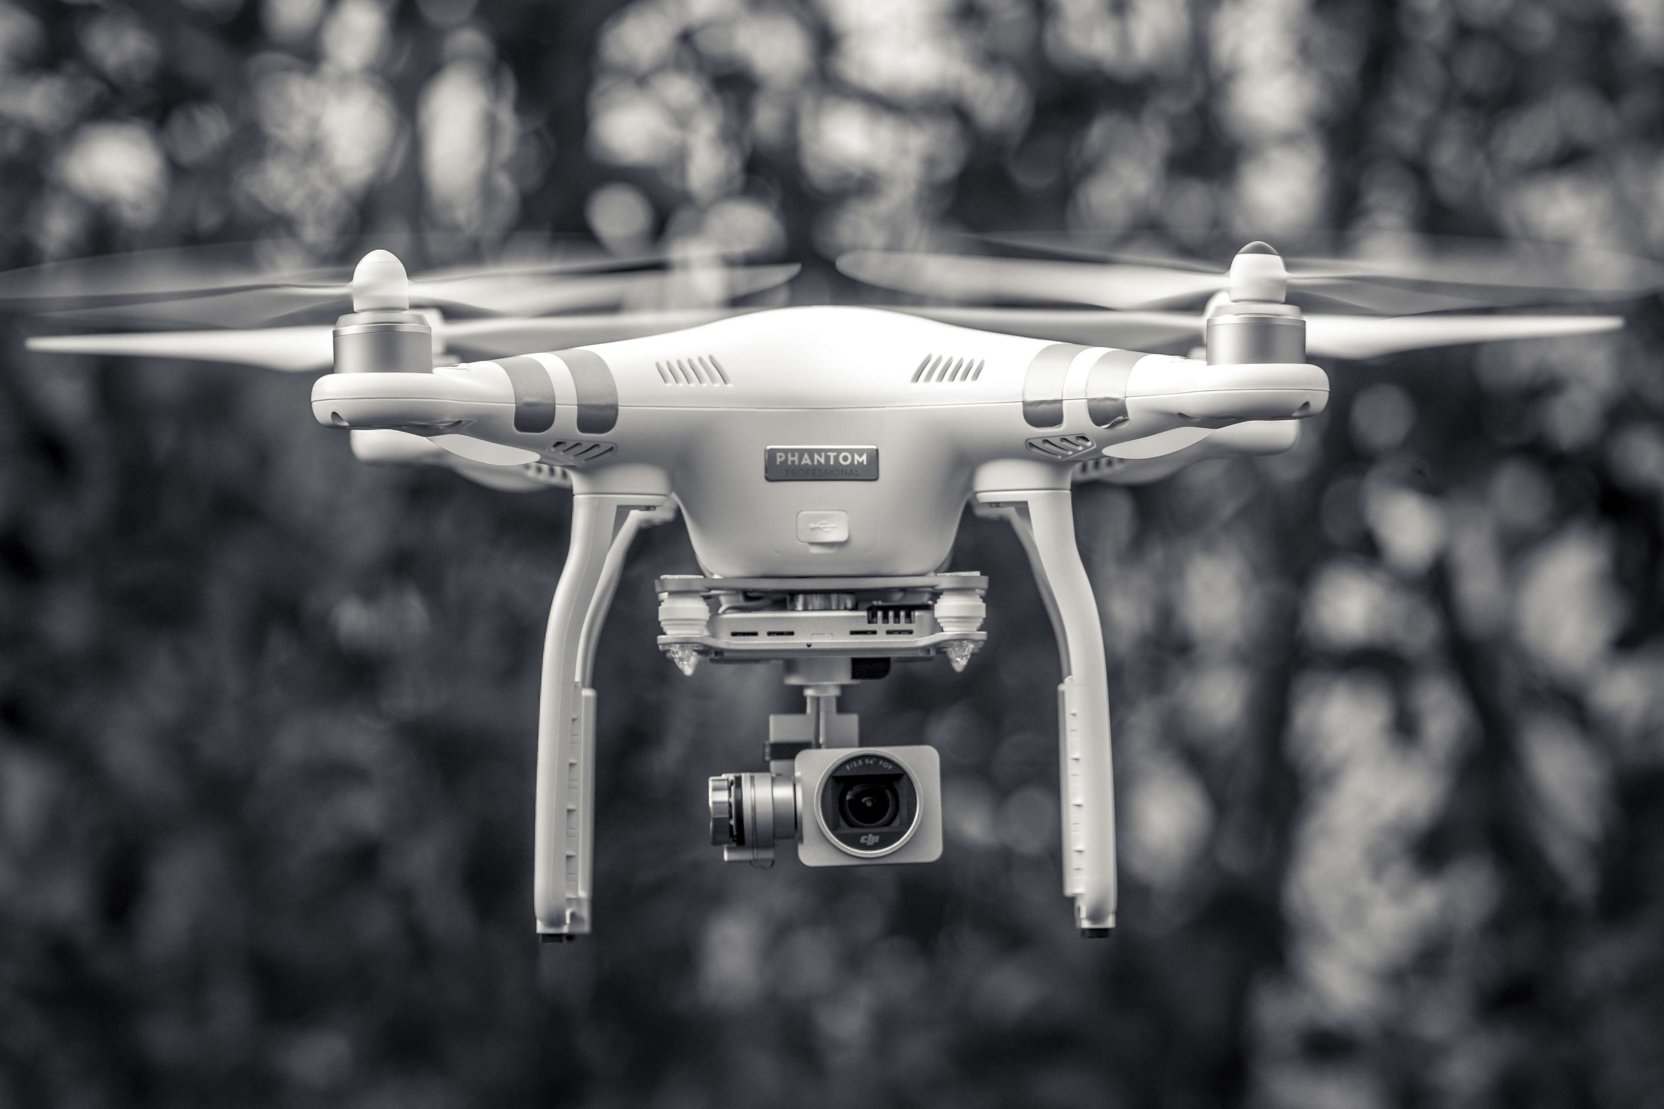
Table of Contents
Case Study
Mathematical Background
Sensor Models
Kalman Filter
Measurement Model
Adaptive Kalman Filter
Unstructured Environment Detection
Matlab Implementation
Simulations
Case Study

Slide 3
Case Study

Slide 4
Introduction
Vehicle
Low-speed quadrocopter for packages transportation
Environment
Confined and partially unstructured environment
Both indoor and outdoor
Fused sensors
MARG
GPS
UWB
Computer vision (with ArUco Markers)
Barometer
Laser altimeter
Case Study

Slide 5
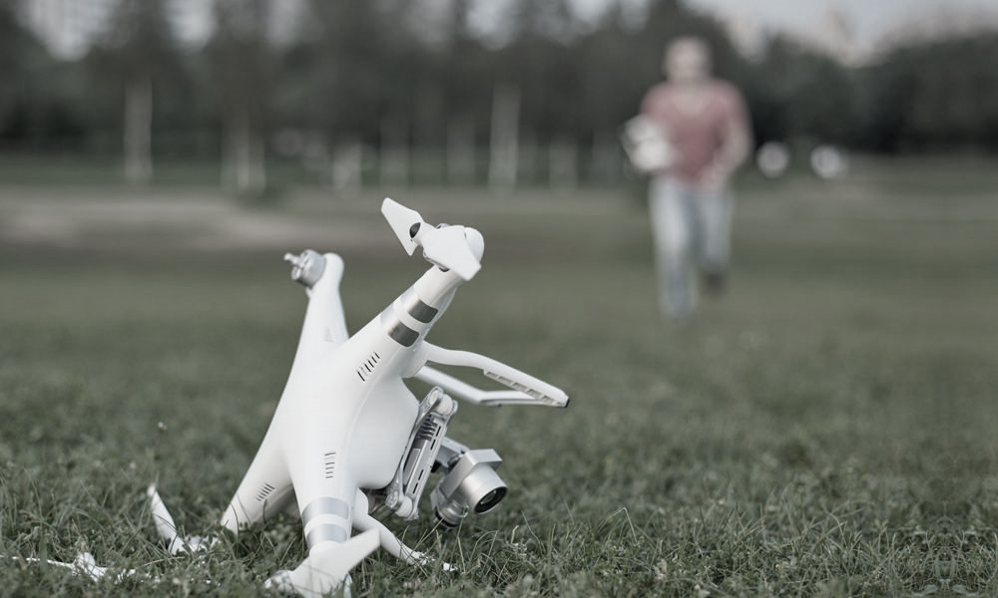
Problems and Difficulties
Integration of multiple sensors with:
Different frames:
rotated sensor reference frames
sensor offset relative to body frame
altimeter measurement dependent on ground height
Unknown frames:
UWB beacons can have unknown positions
ArUco markers can have unknown positions
Case Study

Slide 6
Problems and Difficulties
The sensors are affected by:
Measurement outliers (NLOS errors of GPS and UWB, computer vision errors)
Outages of unknown duration (GPS, UWB, vision)
Variable sensor noises
Environmental disturbances (magnetometer)
Variable measurement rates
Case Study

Slide 7
Filter Design Choices
Error-State (Indirect) Quaternion-Based Adaptively-Robust Extended Sequential Kalman Filter (I-QB-AR-ESKF)
ES avoids the numerical problems and the divergence of the Direct KF
QB guarantees robustness to the (extremely unlikely) singularities of the Euler Angles and a lower computational cost
AR increased robustness to outliers, disturbances and sensor errors in addition to adaptiveness
EKF industry standard, enormous availability of literature, appropriate trade-off between accuracy, computational cost and simplicity
S suitable for estimation with sensors with different measurement rates, reduced computational cost
Case Study

Slide 8
Mathematical Background

Slide 9
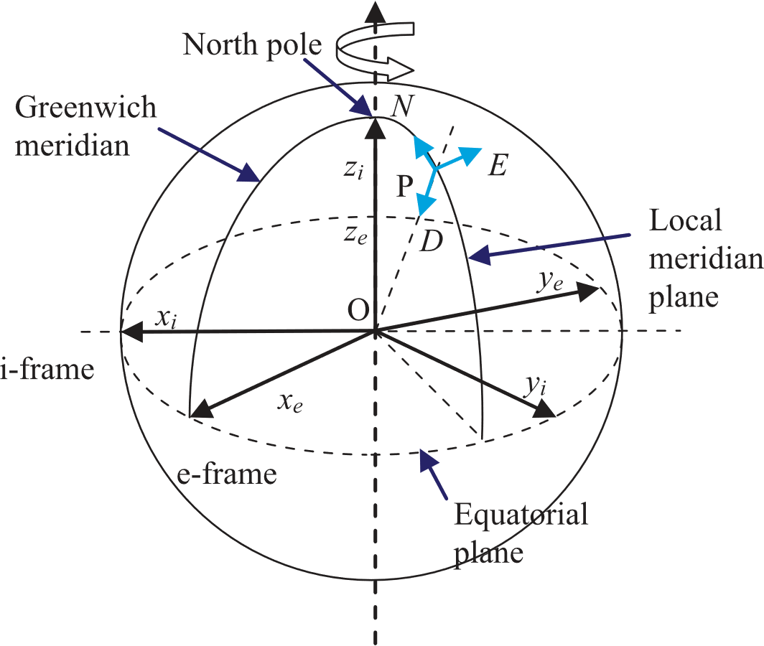
Reference Frames
Used reference frames (RF):
Navigation Frame (n)
Body Frame (b)
i-th Sensor Frame (s_{i})
Camera Frame (c)
Mathematical Background

Slide 10
Reference Frames
Used navigation frame
North-East-Down (NED) Local Geographic Frame
Output coordinate system
More efficient and meaningful to provide the output coordinates directly in NED frame, not in the geodetic frame.
(The UAV needs to operate only in a fixed and confined environment)
Mathematical Background

Slide 11
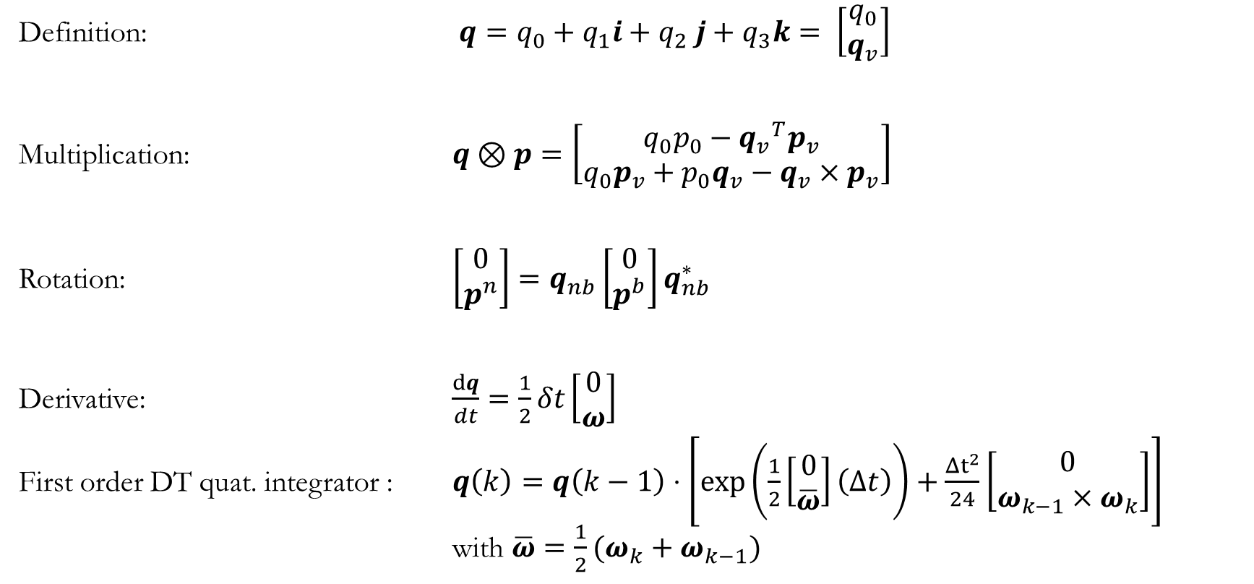
Quaternions and Rotations
Definition: $q=q_{0}+q_{1}i+q_{2} j+q_{3}k= \left[\begin{matrix}q_{0} \\ q_{v}\end{matrix}\right]$
Multiplication: $q \text{⊗} p=\left[\begin{matrix}q_{0}p_{0}−{q_{v}}^{T}p_{v} \\ q_{0}p_{v}+p_{0}q_{v}−q_{v}×p_{v}\end{matrix}\right]$
Rotation: $\left[\begin{matrix}0 \\ p^{n}\end{matrix}\right]=q_{nb}\left[\begin{matrix}0 \\ p^{b}\end{matrix}\right]q_{nb}^{∗}$
Derivative: $\frac{dq}{dt}=\frac{1}{2}δt\left[\begin{matrix}0 \\ ω\end{matrix}\right]$
First order DT quat. integrator : $q\left(k\right)=q\left(k−1\right)⋅\left[\exp\left(\frac{1}{2}\left[\begin{matrix}0 \\ \overline{ω}\end{matrix}\right]\left(Δt\right)\right)+\frac{Δt^{2}}{24}\left[\begin{matrix}0 \\ ω_{k−1}×ω_{k}\end{matrix}\right]\right]$ with $\overline{ω}={\frac{1}{2}(ω}_{k}+ω_{k−1})$
Mathematical Background

Slide 12
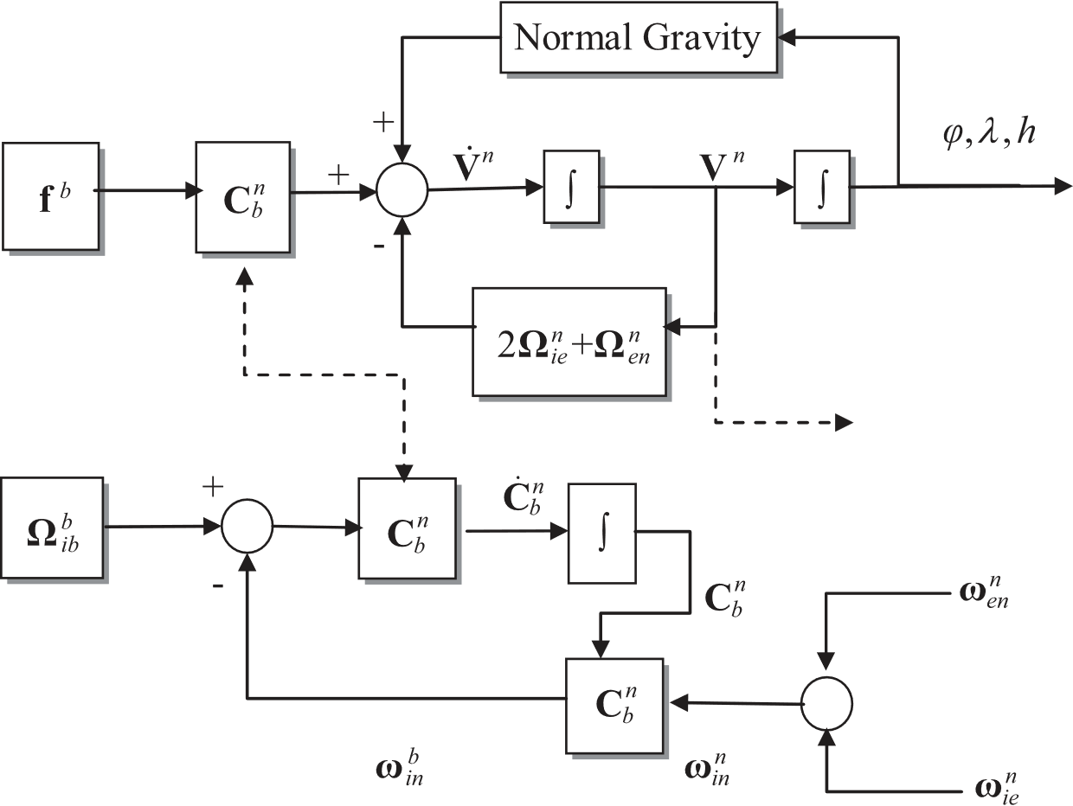
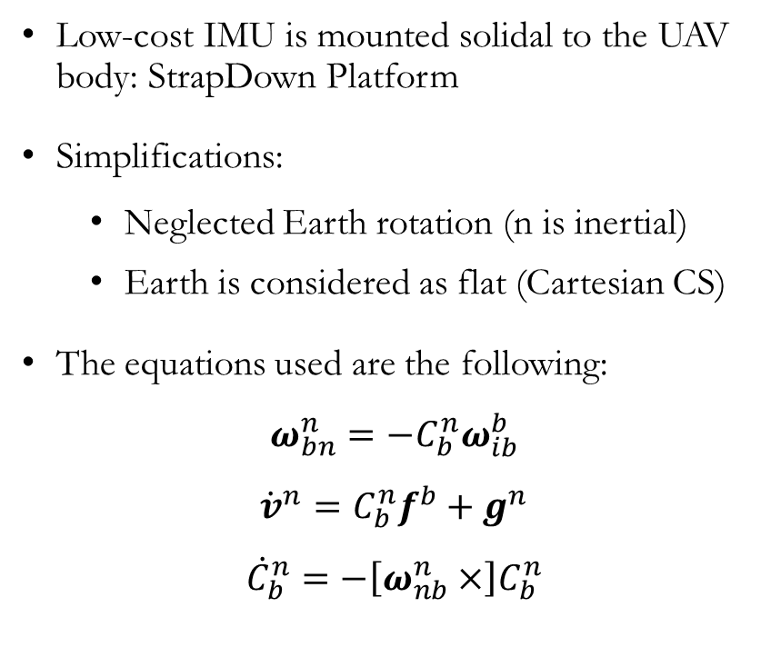
StrapDown Platform
Low-cost IMU is mounted solidal to the UAV body: StrapDown Platform
Simplifications:
Neglected Earth rotation (n is inertial)
Earth is considered as flat (Cartesian CS)
The equations used are the following:
$$ω_{bn}^{n}=−C_{b}^{n}ω_{ib}^{b}$$
$${\dot{v}}^{n}=C_{b}^{n}f^{b}+g^{n}$$
$${\dot{C}}_{b}^{n}=−\left[ω_{nb}^{n}×\right]C_{b}^{n}$$
Mathematical Background

Slide 13
Sensor Models

Slide 14
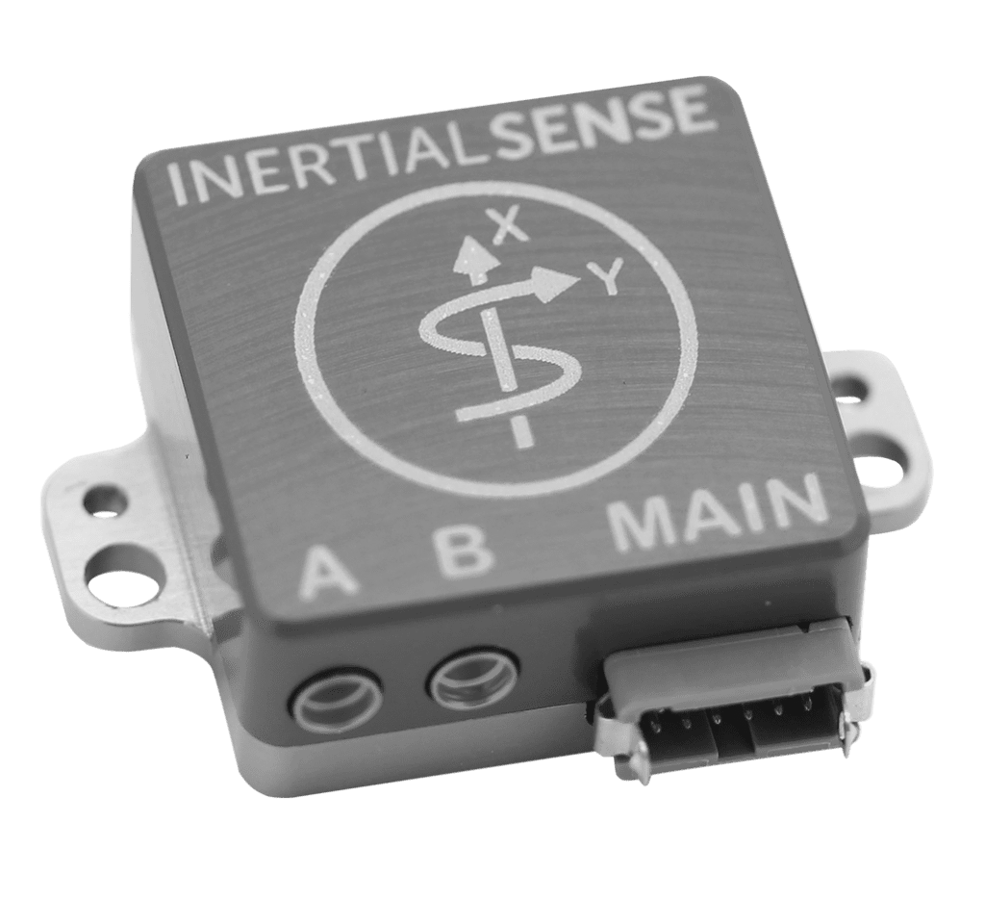
Inertial Measurement Unit
Acceleromer + Gyroscope + Magnetometer
Simulated using the MATLAB function imuSensor present in the Sensor Fusion toolbox.
The considered errors are white noise, bias and quantization.
It is supposed that other sources of errors (such as axis misalignments and magnetometers soft-iron distortions) have been compensated with a previously performed sensor calibration.
IMU
Sensor Models

Slide 15

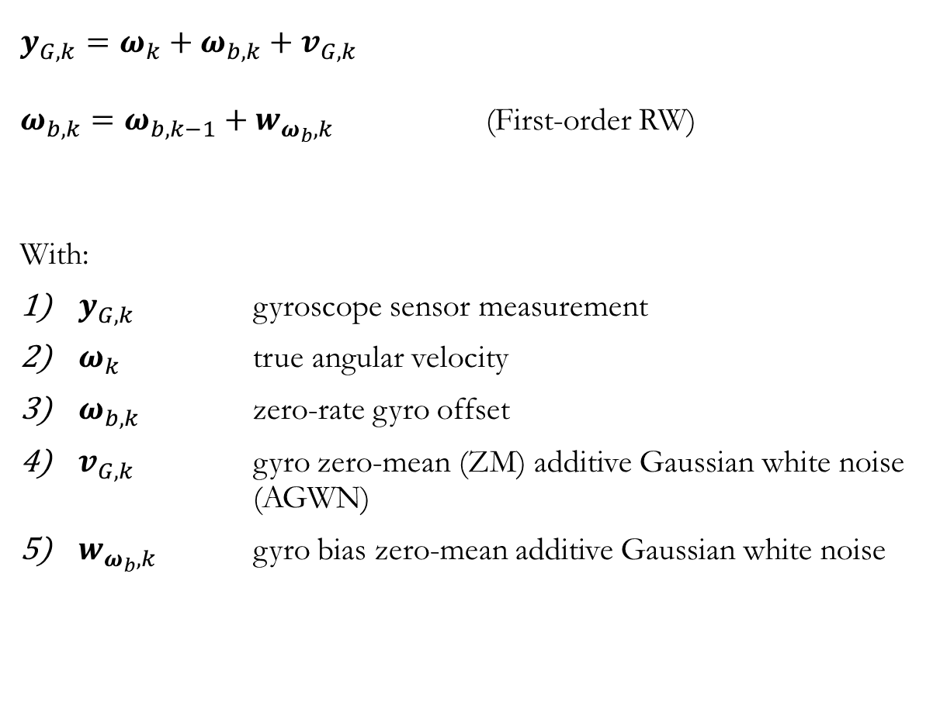
Gyroscope
$$y_{G,k}=ω_{k}+ω_{b,k}+v_{G,k}$$
$ω_{b,k}=ω_{b,k−1}+w_{ω_{b},k}$ (First-order RW)
With:
$y_{G,k}$ gyroscope sensor measurement
$ω_{k}$ true angular velocity
$ω_{b,k}$ zero-rate gyro offset
$v_{G,k}$ gyro zero-mean (ZM) additive Gaussian white noise (AGWN)
$w_{ω_{b},k}$ gyro bias zero-mean additive Gaussian white noise
Sensor Models

Slide 16
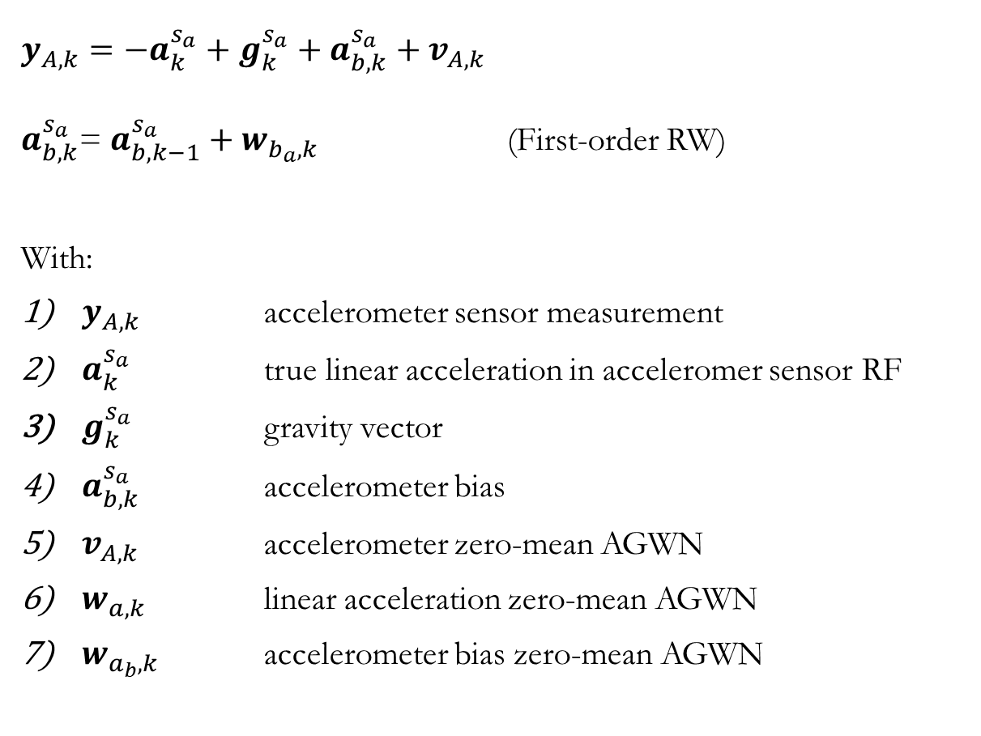
$$y_{A,k}=−a_{k}^{s_{a}}+g_{k}^{s_{a}}+a_{b,k}^{s_{a}}+v_{A,k}$$
$a_{b,k}^{s_{a}}$= $a_{b,k−1}^{s_{a}}+w_{b_{a},k}$ (First-order RW)
With:
$y_{A,k}$ accelerometer sensor measurement
$a_{k}^{s_{a}}$ true linear acceleration in acceleromer sensor RF
$g_{k}^{s_{a}}$ gravity vector
$a_{b,k}^{s_{a}}$ accelerometer bias
$v_{A,k}$ accelerometer zero-mean AGWN
$w_{a,k}$ linear acceleration zero-mean AGWN
$w_{a_{b},k}$ accelerometer bias zero-mean AGWN
Accelero-
meter
Sensor Models

Slide 17
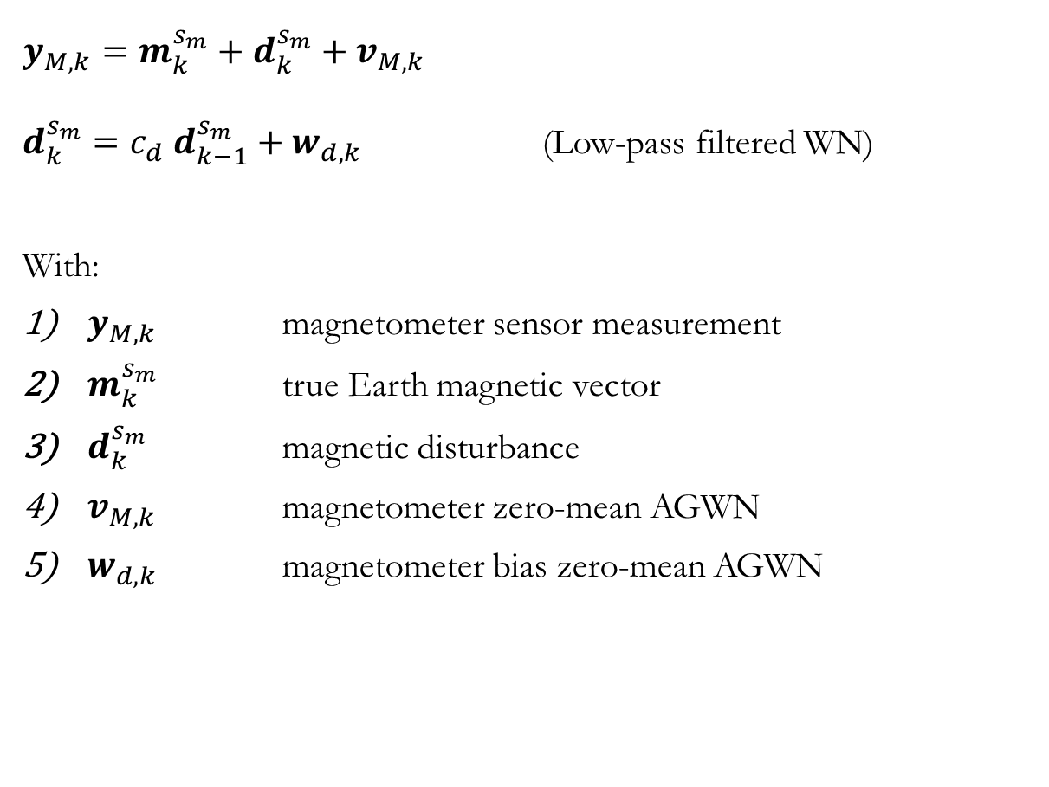
$$y_{M,k}=m_{k}^{s_{m}}+d_{k}^{s_{m}}+v_{M,k}$$
$d_{k}^{s_{m}}=c_{d} d_{k−1}^{s_{m}}+w_{d,k}$ (Low-pass filtered WN)
With:
$y_{M,k}$ magnetometer sensor measurement
$m_{k}^{s_{m}}$ true Earth magnetic vector
$d_{k}^{s_{m}}$ magnetic disturbance
$v_{M,k}$ magnetometer zero-mean AGWN
$w_{d,k}$ magnetometer bias zero-mean AGWN
Magneto-
meter
Sensor Models

Slide 18

GPS
Position
Global Positioning System
Both the position and the velocity measurements are accessible by the navigation system.
Simulated using the MATLAB function gpsSensor present in the Sensor Fusion toolbox, considering white noises (different on lat-long and on altitude) and bias errors.
Loosely-coupled integration:
PRO: easier implementation, lower computational cost
CONS: worse accuracy compared to Tightly-coupled and GPS-RTS integration, problems with low satellites count
Sensor Models

Slide 19
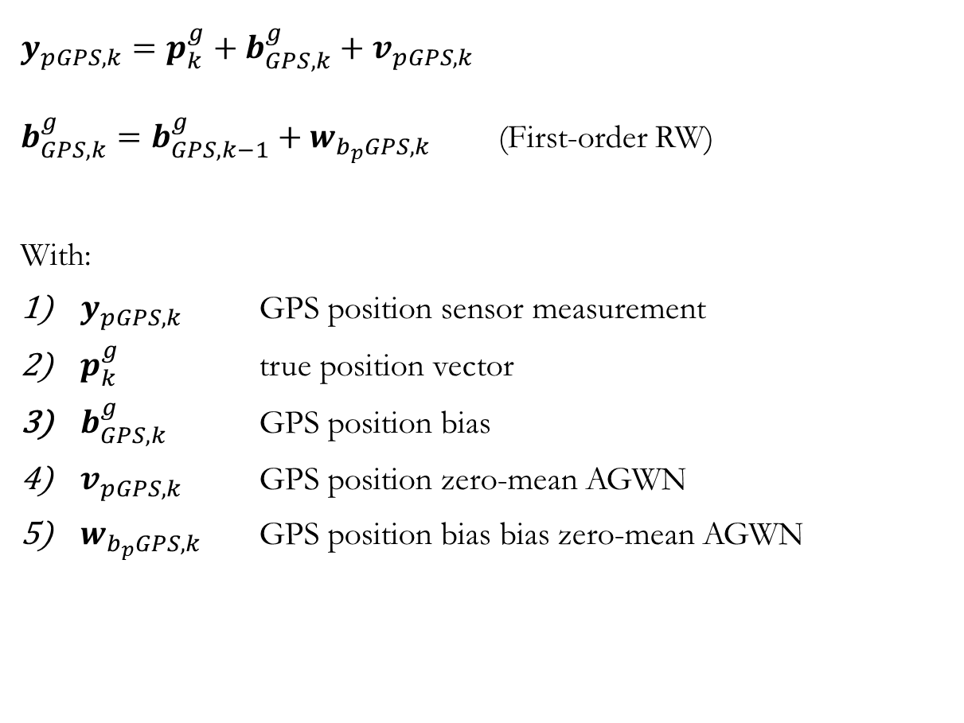
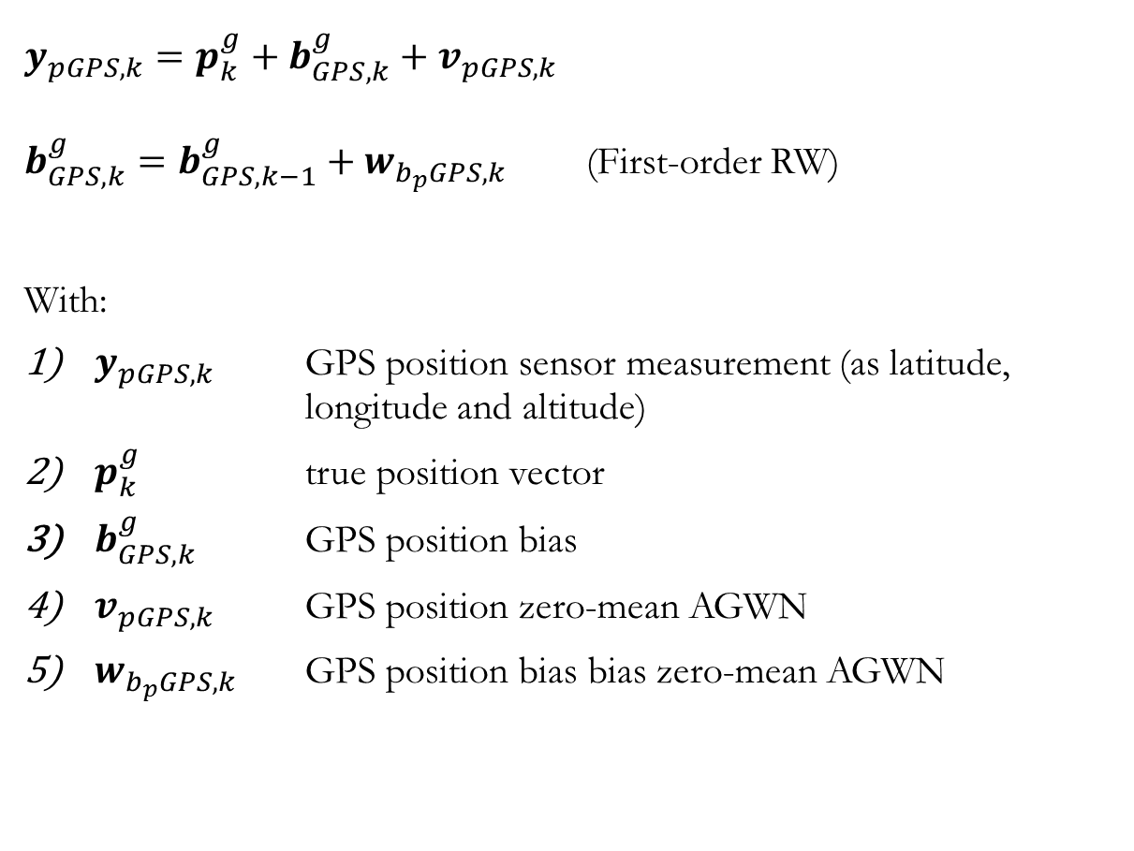
GPS
Position
$$y_{pGPS,k}=p_{k}^{g}+b_{GPS, k}^{g}+v_{pGPS,k}$$
$b_{GPS,k}^{g}=b_{GPS,k−1}^{g}+w_{b_{p}GPS,k}$ (First-order RW)
With:
$y_{pGPS,k}$ GPS position sensor measurement (as latitude, longitude and altitude)
$p_{k}^{g}$ true position vector
$b_{GPS, k}^{g}$ GPS position bias
$v_{pGPS,k}$ GPS position zero-mean AGWN
$w_{b_{p}GPS,k}$ GPS position bias bias zero-mean AGWN
Sensor Models

Slide 20
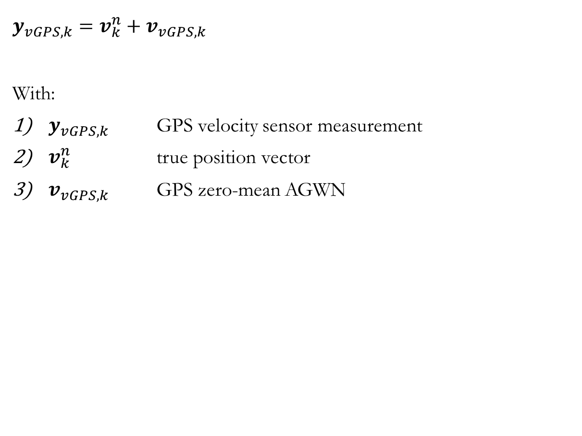
GPS
Velocity
$$y_{vGPS,k}=v_{k}^{n}+v_{vGPS,k}$$
With:
$y_{vGPS,k}$ GPS velocity sensor measurement
$v_{k}^{n}$ true position vector
$v_{vGPS,k}$ GPS zero-mean AGWN
Sensor Models

Slide 21
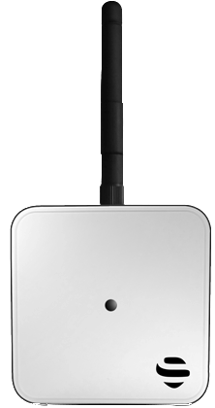
UWB
Ultra WideBand
Simulated using the custom system object uwb_sensor.
It is possible to set the beacons positions and ids (as vectors), the beacons maximum and minimum range, the measurement noise and the RNG seed.
Function call: [meas_dist, id] = uwb(drone_pos, unobstructed_ids)
Where the second input is used to take into account the fact that walls may obstruct some beacons signal.
No NLOS errors, only WGN and quantization errors are considered.
Sensor Models

Slide 22
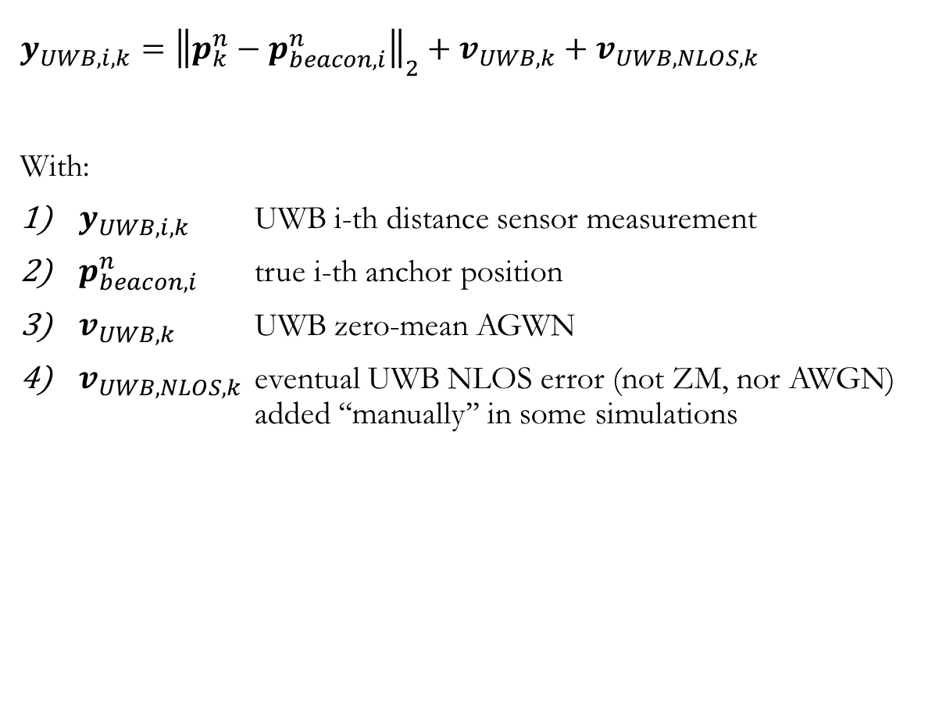
UWB
$$y_{UWB,i,k}={\left\|p_{k}^{n}−p_{beacon,i}^{n}\right\|}_{2}+v_{UWB,k}+v_{UWB,NLOS,k}$$
With:
$y_{UWB,i,k}$ UWB i-th distance sensor measurement
$p_{beacon,i}^{n}$ true i-th anchor position
$v_{UWB,k}$ UWB zero-mean AGWN
$v_{UWB,NLOS,k}$ eventual UWB NLOS error (not ZM, nor AWGN) added ‘‘manually’’ in some simulations
Sensor Models

Slide 23

Computer Vision
Computer Vision: ArUco markers
Simulated using the custom system object aruco_vision_sensor.
It is possible to set the marker positions and ids (vectors), the vision system maximum range, the measurement noise and the RNG seed. It is also possible to set the camera (optical center) position and orientation relative to the body frame.
Function call: [Tcm, id] = aruco(drone_orientaion, drone_position)
The output is a homogeneous roto-traslation matrix.
Sensor Models

Slide 24
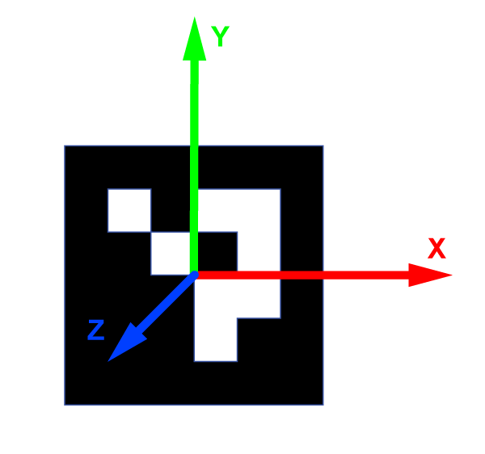
Computer Vision
Errors
Some considerations have been done regarding the principles of the computer vision to model its errors.
It has been determined that the errors increases when the camera-marker distance increases; in addition they are not the same on all directions.
It is not considered the case where the marker plane is parallel to the line of sight, which would increase the errors. The z axis thus is similar to the line of sight direction.
Sensor Models

Slide 25
Computer Vision
Errors
Orientation error: multiplicative error matrix with (small) Euler angles. These Euler angles have a statistical distribution which is the sum of a ZM-GWN and another ZM_GWN multiplied by the camera-marker distance. The errors on the yaw angle are smaller than the ones on the roll and pitch angles.
Position error: additive errors. The error is again distributed as the sum of a ZM-GWN and another ZM_GWN multiplied by the camera-marker distance. This time the error along the z-axis is greater than the one on the other axes (considering that the marker plane is roughly perpendicular to the LOS).
Sensor Models

Slide 26
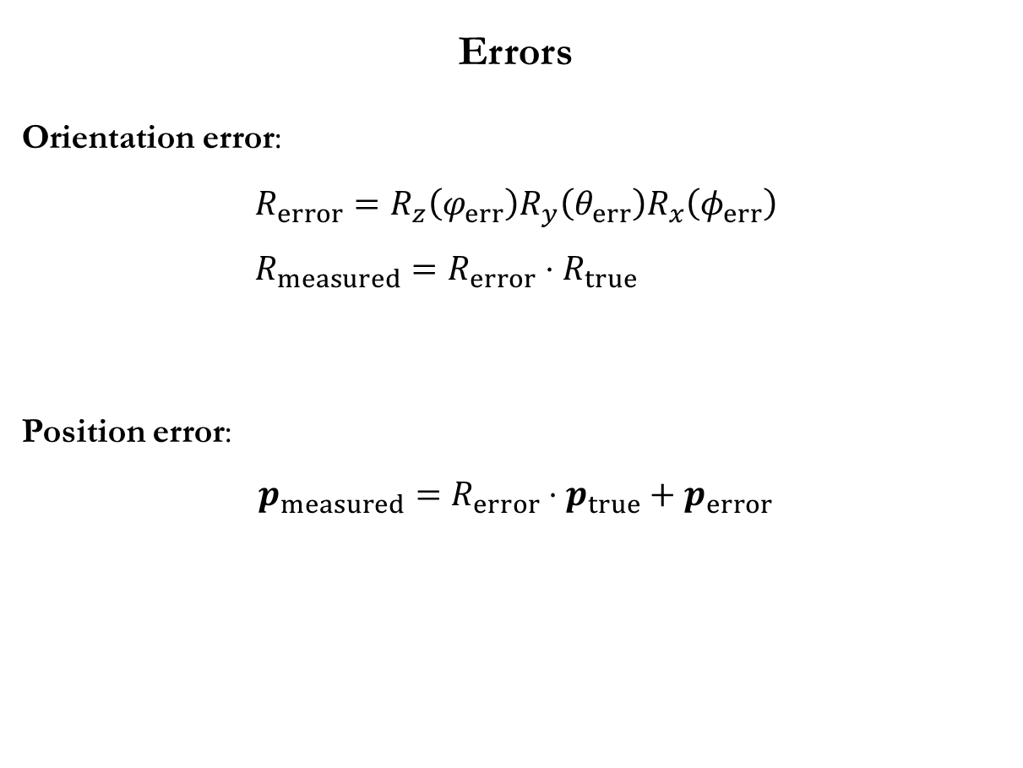
Computer Vision
Errors
Orientation error:
$$R_{error}=R_{z}\left(φ_{err}\right)R_{y}\left(θ_{err}\right)R_{x}\left(φ_{err}\right) \\ R_{measured}=R_{error}⋅R_{true}$$
Position error:
$$p_{measured}=R_{error}⋅p_{true}+p_{error}$$
Sensor Models

Slide 27
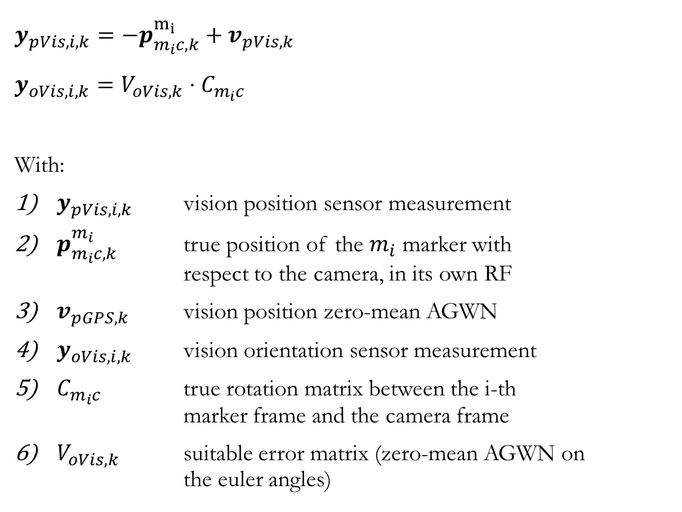
Computer Vision
$$y_{pVis,i,k}=−p_{m_{i}c,k}^{m_{i}}+v_{pVis,k}$$
$$y_{oVis,i,k}=V_{oVis,k}⋅C_{m_{i}c}$$
With:
$y_{pVis,i,k}$ vision position sensor measurement
$p_{m_{i}c,k}^{m_{i}}$ true position of the $m_{i}$ marker with respect to the camera, in its own RF
$v_{pGPS,k}$ vision position zero-mean AGWN
$y_{oVis,i,k}$ vision orientation sensor measurement
$C_{m_{i}c}$ true rotation matrix between the i-th marker frame and the camera frame
$V_{oVis,k}$ suitable error matrix (zero-mean AGWN on the euler angles)
Sensor Models

Slide 28
Barometer
Altimeter
Simulated using the custom system object: barometer_sensor
It is supposed that the sensor itself performs the conversion between pressure and altitude, and the output provided is the altitude.
The displacement of the sensor w.r.t. the drone COM is neglected.
The sources of errors are AWGN, bias instability and quantization.
Simulated using the custom system object: altimeter_sensor
Both the position of the sensor on the drone and the drone’s pose are considered.
In addition, the ground height is not supposed constant.
The sources of errors are AWGN, bias instability and quantization.
Sensor Models

Slide 29
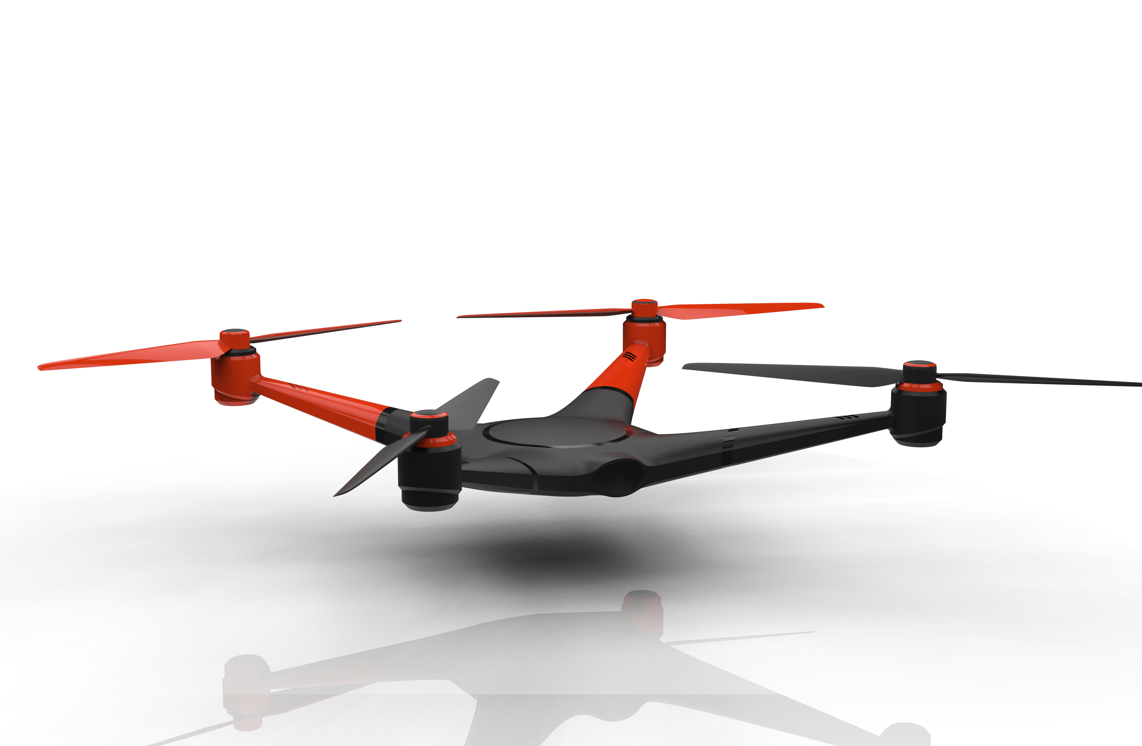

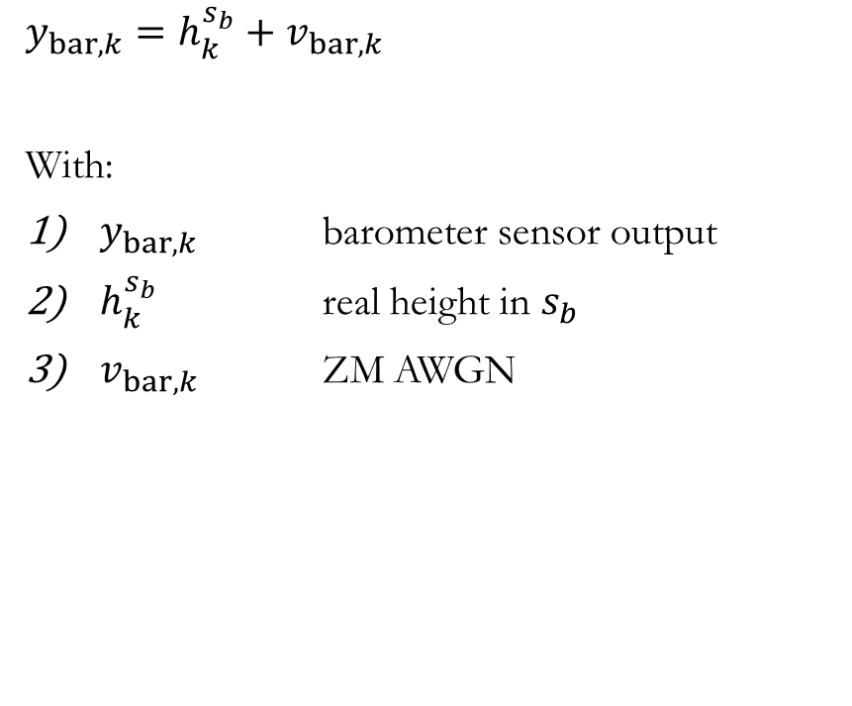
Barometer
Altimeter
$$y_{bar,k}=h_{k}^{s_{b}}+v_{bar,k}$$
With:
$y_{bar,k}$ barometer sensor output
$h_{k}^{s_{b}}$ real height in $s_{b}$
$v_{bar,k}$ ZM AWGN
$$y_{alt,k}=\frac{h_{k}^{n}−h_{sensor,k}^{n}−h_{g,k}^{n}}{cos⁡(φ_{vertical})}+v_{alt,k}$$
With:
$y_{alt,k}$ altimeter sensor output
$h_{k}^{n}$ real altitude (from ground) (NED)
$h_{sensor,k}^{n}$ height of the sensor w.r.t. the drone COM
$h_{g,k}^{n}$ ground height
$φ_{vertical}$ angle with the vertical
$v_{alt,k}$ ZM AWGN
Sensor Models

Slide 30
Kalman Filter

Slide 31
Kalman filters
Two different Kalman filters have been developed:
my_navigation_filter_adaptive: the main filter used for the navigation of the drone. It is composed of two separates modules: one main module used exclusively for the navigation of the drone. The other module is used to deal with the unknown beacons position estimation, it has thus a state of variable dimension (it depends on the number of different anchors detected) that includes the coordinates of the unknown anchors and the square sum of the coordinates (4 scalars per anchor).
detect_marker: this smaller Kalman filter is used to estimate the position of the unknown markers representing the mission objective(s). This is described more in detail in the ‘‘Unstructured Environment Detection Section’’. It has as inputs the vision sensor measurements and the drone pose; its outputs are the marker position, orientation and velocity.
The Kalman filter description will start with the description of my_navigation_filter_adaptive.
Kalman Filter

Slide 32
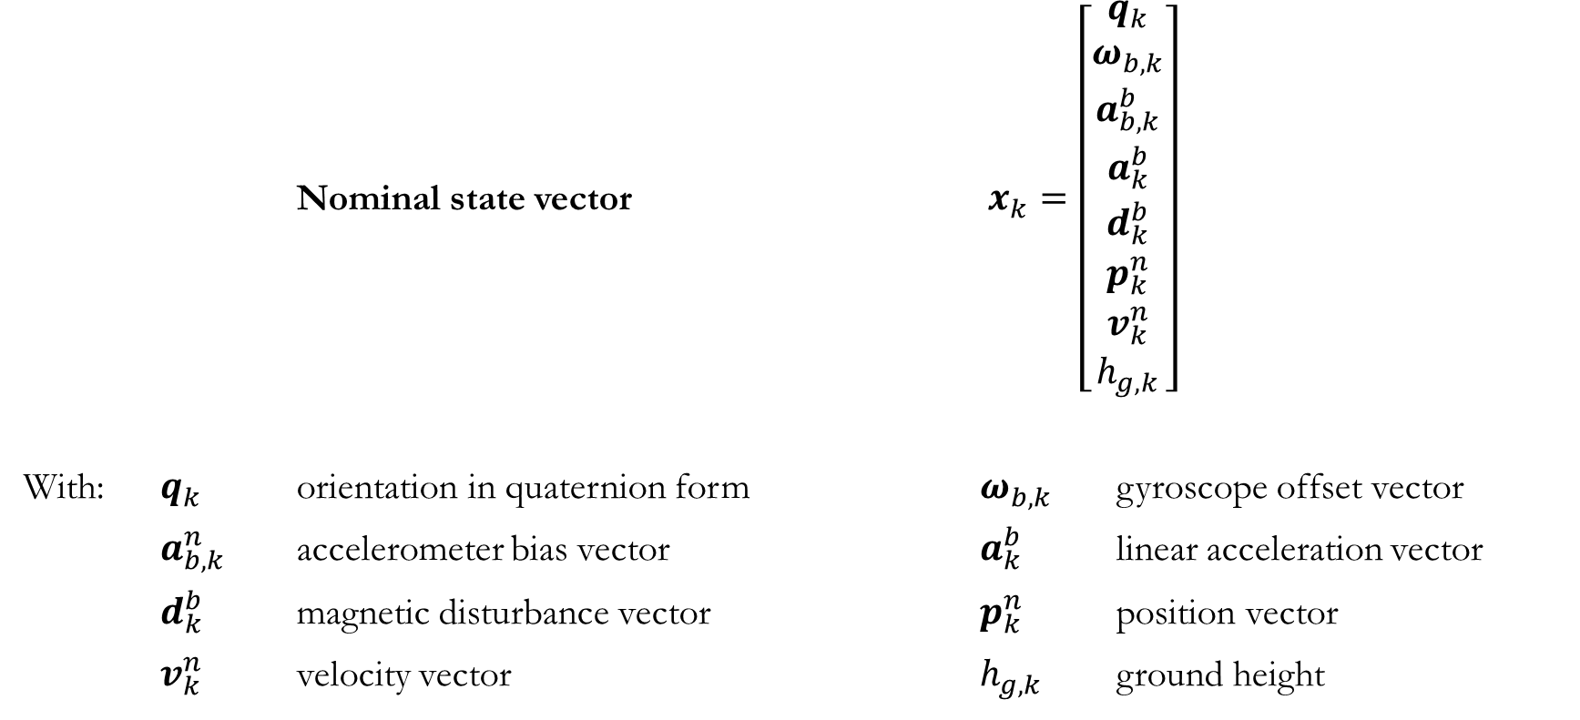
Nominal State Vector
Nominal state vector $x_{k}=\left[\begin{aligned}q_{k} \\ ω_{b,k} \\ a_{b,k}^{b} \\ a_{k}^{b} \\ d_{k}^{b} \\ p_{k}^{n} \\ v_{k}^{n} \\ h_{g,k}\end{aligned}\right]$
With: $q_{k}$ orientation in quaternion form $ω_{b,k}$ gyroscope offset vector
$a_{b, k}^{n}$ accelerometer bias vector $a_{k}^{b}$ linear acceleration vector
$d_{k}^{b}$ magnetic disturbance vector $p_{k}^{n}$ position vector
$v_{k}^{n}$ velocity vector $h_{g,k}$ ground height
Kalman Filter

Slide 33
Nominal State Vector
Nominal state vector $x_{k}=\left[\begin{aligned}q_{k} \\ ω_{b,k} \\ a_{b,k}^{b} \\ a_{k}^{b} \\ d_{k}^{b} \\ p_{k}^{n} \\ v_{k}^{n} \\ h_{g,k}\end{aligned}\right]$
With: $q_{k}$ orientation in quaternion form $ω_{b,k}$ gyroscope offset vector
$a_{b, k}^{n}$ accelerometer bias vector $a_{k}^{b}$ linear acceleration vector
$d_{k}^{b}$ magnetic disturbance vector $p_{k}^{n}$ position vector
$v_{k}^{n}$ velocity vector $h_{g,k}$ ground height
Kalman Filter

Slide 34
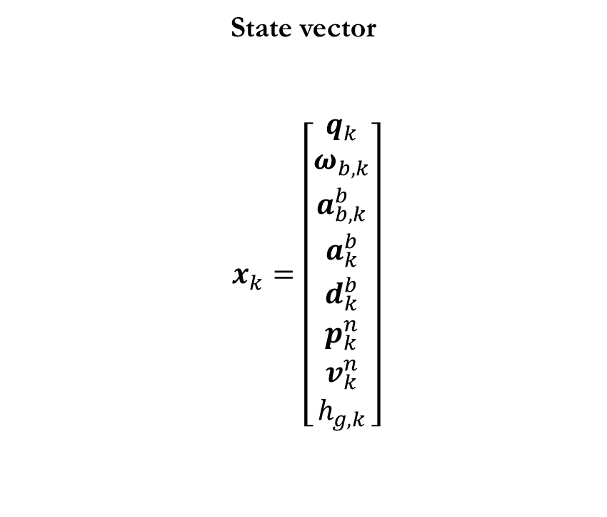
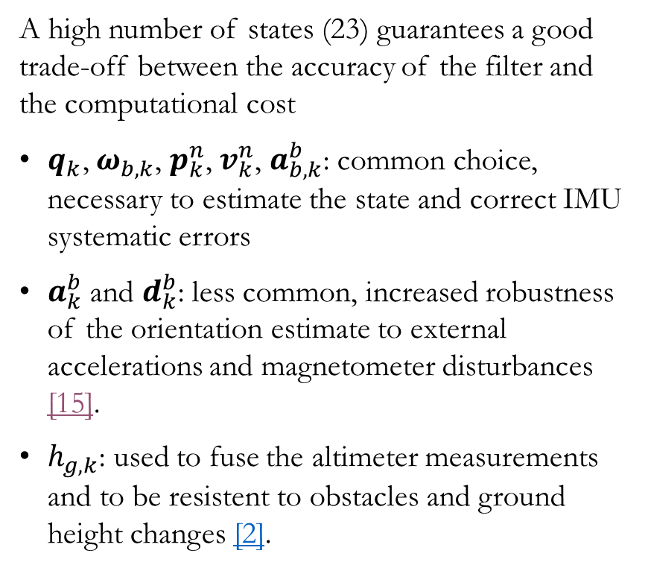
State Vector
State vector
$$x_{k}=\left[\begin{aligned}q_{k} \\ ω_{b,k} \\ a_{b,k}^{b} \\ a_{k}^{b} \\ d_{k}^{b} \\ p_{k}^{n} \\ v_{k}^{n} \\ h_{g,k}\end{aligned}\right]$$
A high number of states (23) guarantees a good trade-off between the accuracy of the filter and the computational cost
$q_{k}\text{,}{ ω}_{b,k}$, $p_{k}^{n}$, $v_{k}^{n}$, $a_{b,k}^{b}$: common choice, necessary to estimate the state and correct IMU systematic errors
$a_{k}^{b}$ and $d_{k}^{b}$: less common, increased robustness of the orientation estimate to external accelerations and magnetometer disturbances [15].
$h_{g,k}$: used to fuse the altimeter measurements and to be resistent to obstacles and ground height changes [2].
Kalman Filter

Slide 35
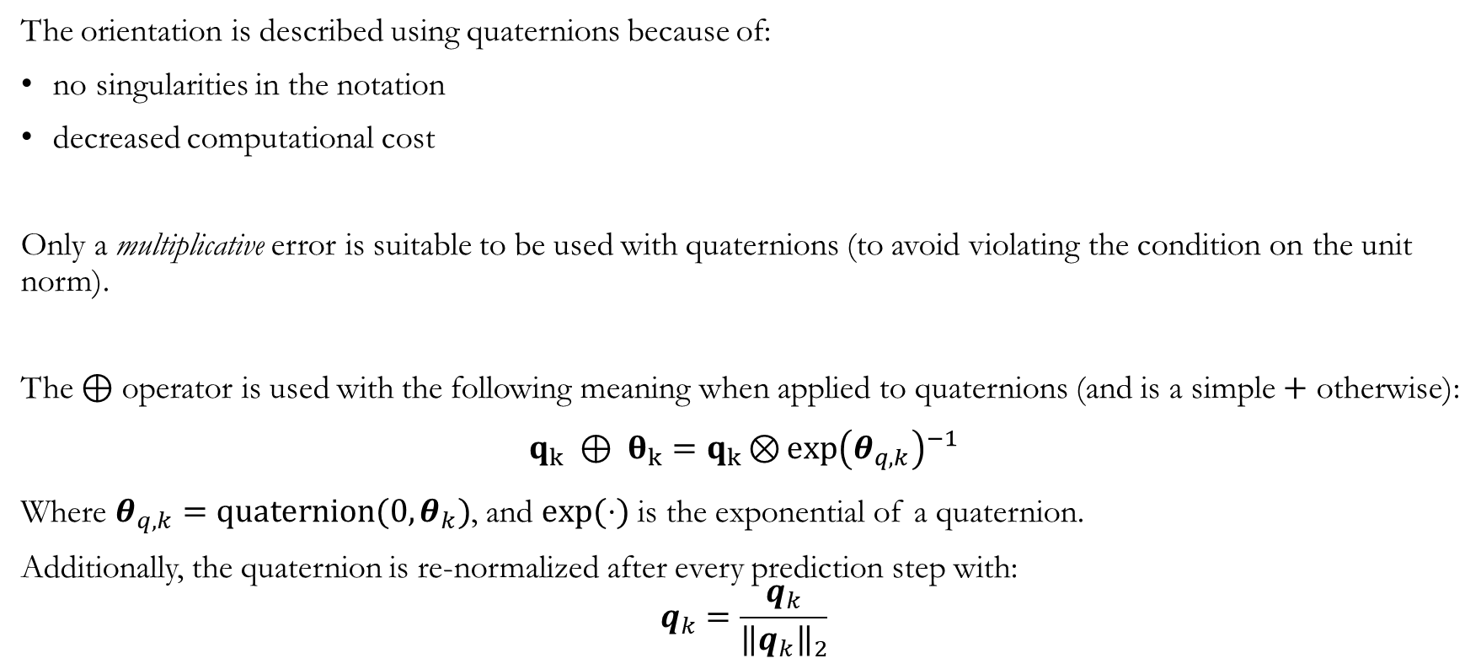
Quaternion Approach
The orientation is described using quaternions because of:
no singularities in the notation
decreased computational cost
Only a multiplicative error is suitable to be used with quaternions (to avoid violating the condition on the unit norm).
The $⊕$ operator is used with the following meaning when applied to quaternions (and is a simple $+$ otherwise):
$$q_{k} ⊕ θ_{k}=q_{k}{\text{⊗}{exp\left(θ_{q,k}\right)}}^{−1}$$
Where $θ_{q,k}=quaternion(0,θ_{k})$, and $exp⁡(⋅)$ is the exponential of a quaternion.
Additionally, the quaternion is re-normalized after every prediction step with:
$$q_{k}=\frac{q_{k}}{{\left\|q_{k}\right\|}_{2}}$$
Kalman Filter

Slide 36
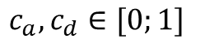
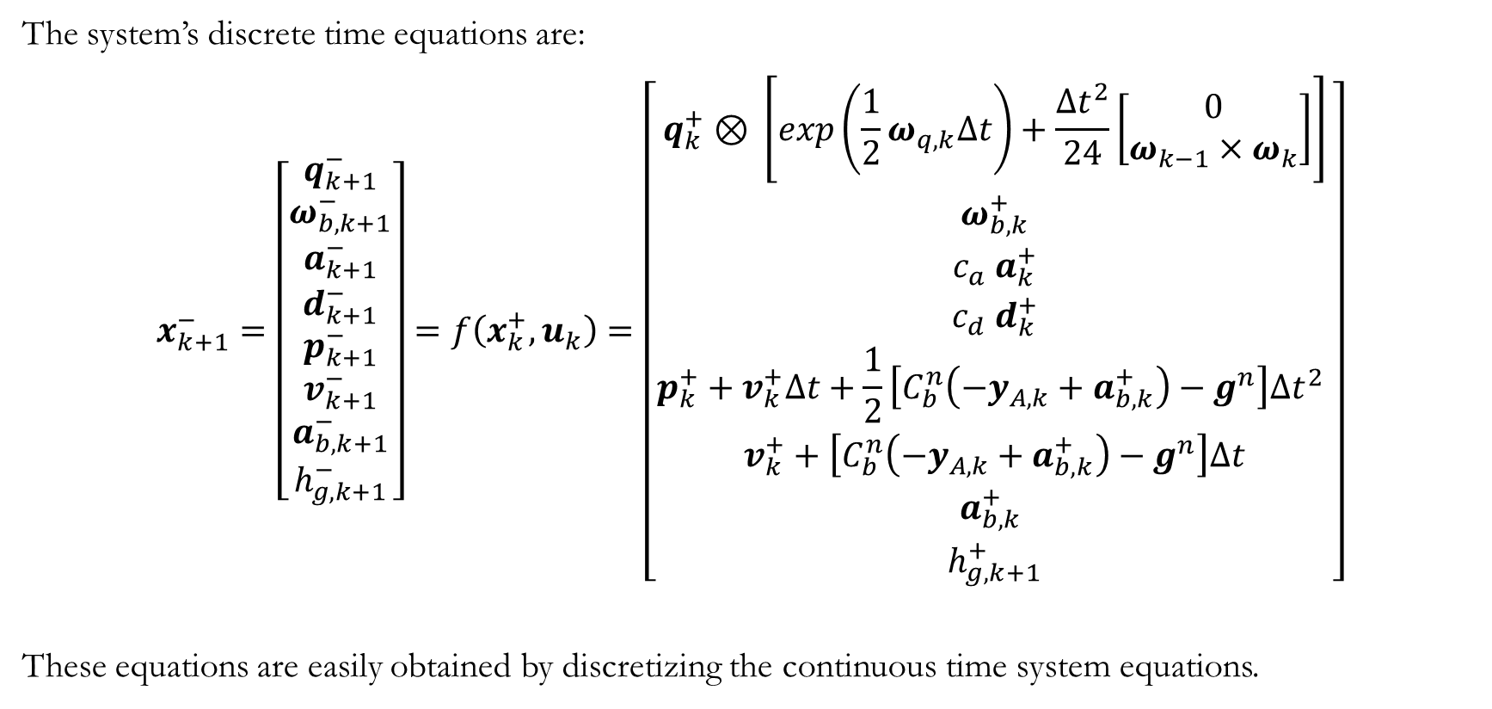
State Update
The system’s discrete time equations are:
$$x_{k+1}^{−}=\left[\begin{aligned}q_{k+1}^{−} \\ ω_{b,k+1}^{−} \\ a_{k+1}^{−} \\ d_{k+1}^{−} \\ p_{k+1}^{−} \\ v_{k+1}^{−} \\ a_{b,k+1}^{−} \\ h_{g,k+1}^{−}\end{aligned}\right]=f\left(x_{k}^{+}, u_{k}\right)=\left[\begin{matrix}q_{k}^{+} \text{⊗ }\left[exp\left({\frac{1}{2}ω}_{q,k}Δt\right)+\frac{Δt^{2}}{24}\left[\begin{matrix}0 \\ ω_{k−1}×ω_{k}\end{matrix}\right]\right] \\ \begin{aligned}ω_{b,k}^{+} \\ c_{a} a_{k}^{+} \\ c_{d} d_{k}^{+} \\ p_{k}^{+}+v_{k}^{+}Δt+\frac{1}{2}\left[C_{b}^{n}\left(−y_{A,k}+a_{b,k}^{+}\right)−g^{n}\right]Δt^{2} \\ v_{k}^{+}+\left[C_{b}^{n}\left({−y}_{A,k}+a_{b,k}^{+}\right)−g^{n}\right]Δt \\ a_{b,k}^{+} \\ h_{g,k+1}^{+}\end{aligned}\end{matrix}\right]$$
These equations are easily obtained by discretizing the continuous time system equations.
$$c_{a},c_{d}∈[0;1]$$
Kalman Filter

Slide 37
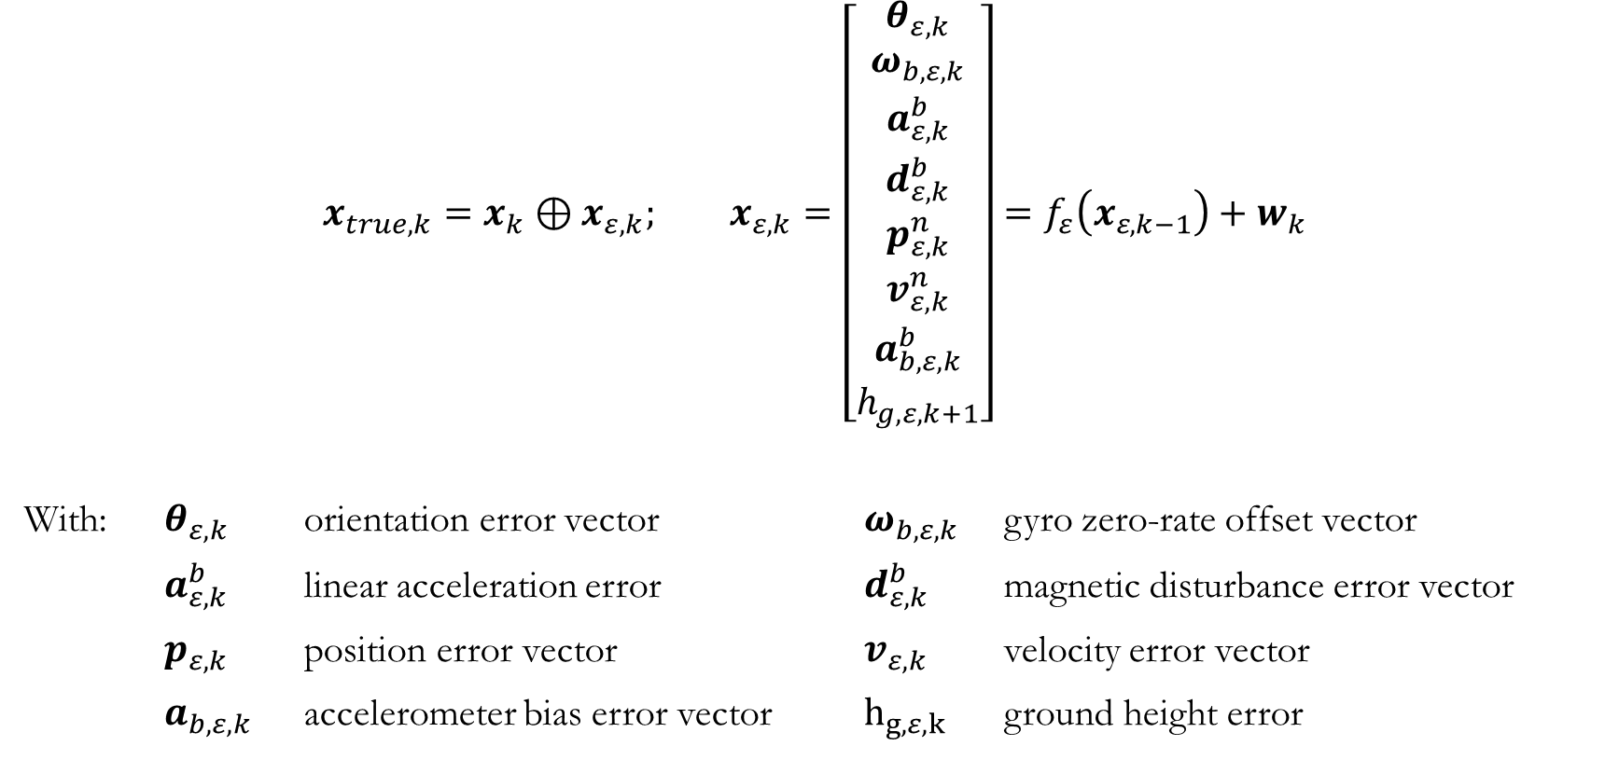
Error State
$$x_{true,k}=x_{k}⊕x_{ε,k}; x_{ε,k}=\left[\begin{aligned}\begin{aligned}θ_{ε,k} \\ ω_{b,ε,k} \\ a_{ε,k}^{b} \\ d_{ε,k}^{b} \\ p_{ε,k}^{n} \\ v_{ε,k}^{n} \\ a_{b,ε,k}^{b}\end{aligned} \\ h_{g,ε,k+1}\end{aligned}\right]=f_{ε}\left(x_{ε,k−1}\right)+w_{k}$$
With: $θ_{ε,k}$ orientation error vector $ω_{b,ε,k}$ gyro zero-rate offset vector
$a_{ε,k}^{b}$ linear acceleration error $d_{ε,k}^{b}$ magnetic disturbance error vector
$p_{ε,k}$ position error vector $v_{ε,k}$ velocity error vector
$a_{b,ε,k}$ accelerometer bias error vector $h_{g,ε,k}$ ground height error
nominal state
Kalman Filter

Slide 38
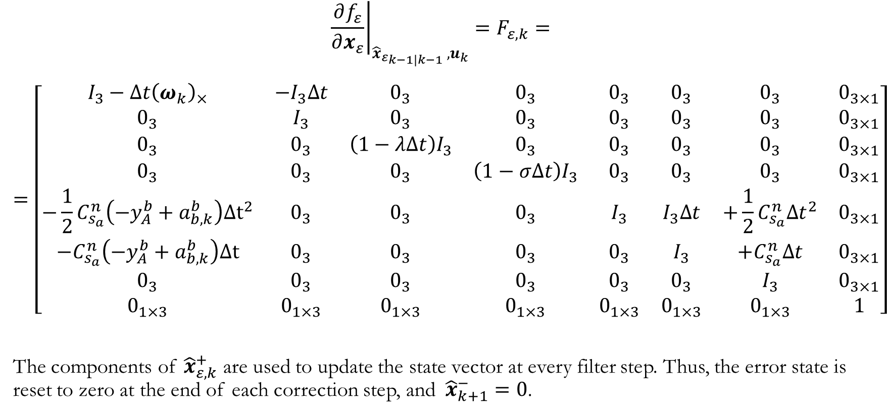
Error Process
$${{\left.\frac{∂f_{ε}}{∂x_{ε}}\right|}_{{{\hat{x}}_{ε}}_{k−1|k−1} ,u_{k}}=F}_{ε,k}=$$
$$=\left[\begin{matrix}I_{3}−Δt{\left(ω_{k}\right)}_{×} & −I_{3}Δt & 0_{3} & 0_{3} & 0_{3} & 0_{3} & 0_{3} & 0_{3×1} \\ 0_{3} & I_{3} & 0_{3} & 0_{3} & 0_{3} & 0_{3} & 0_{3} & 0_{3×1} \\ 0_{3} & 0_{3} & {\left(1−λΔt\right)I}_{3} & 0_{3} & 0_{3} & 0_{3} & 0_{3} & 0_{3×1} \\ 0_{3} & 0_{3} & 0_{3} & {\left(1−σΔt\right)I}_{3} & 0_{3} & 0_{3} & 0_{3} & 0_{3×1} \\ −\frac{1}{2}C_{s_{a}}^{n}\left({−y}_{A}^{b}+a_{b,k}^{b}\right)Δt^{2} & 0_{3} & 0_{3} & 0_{3} & I_{3} & I_{3}Δt & +\frac{1}{2}C_{s_{a}}^{n}Δt^{2} & 0_{3×1} \\ {−C}_{s_{a}}^{n}\left(−y_{A}^{b}+a_{b,k}^{b}\right)Δt & 0_{3} & 0_{3} & 0_{3} & 0_{3} & I_{3} & {+C}_{s_{a}}^{n}Δt & 0_{3×1} \\ 0_{3} & 0_{3} & 0_{3} & 0_{3} & 0_{3} & 0_{3} & I_{3} & 0_{3×1} \\ 0_{1×3} & 0_{1×3} & 0_{1×3} & 0_{1×3} & 0_{1×3} & 0_{1×3} & 0_{1×3} & 1\end{matrix}\right]$$
The components of ${\hat{x}}_{ε,k}^{+}$ are used to update the state vector at every filter step. Thus, the error state is reset to zero at the end of each correction step, and ${\hat{x}}_{k+1}^{−}=0$.
Kalman Filter

Slide 39
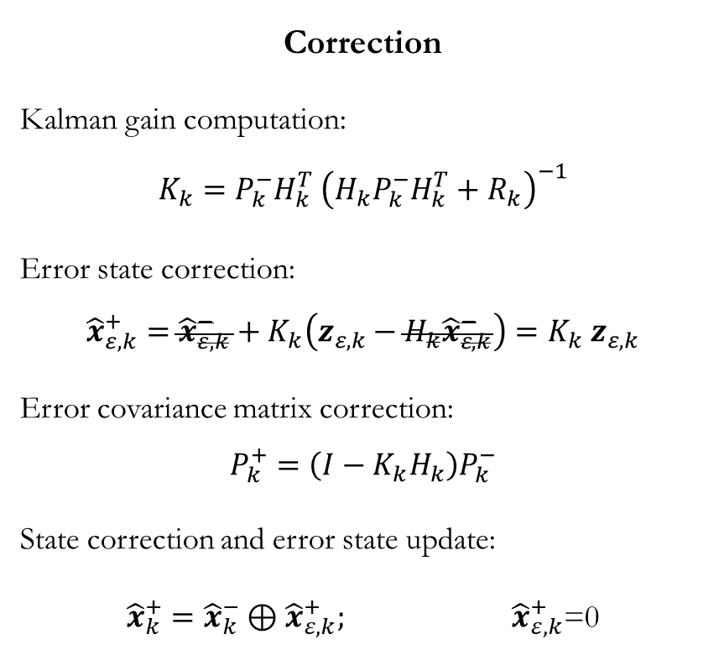
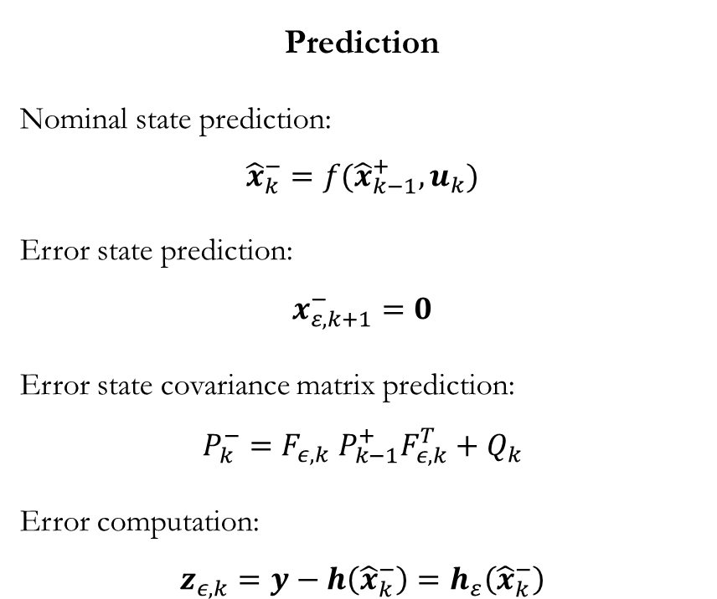
Kalman Filter Equations
Prediction
Nominal state prediction:
$${\hat{x}}_{k}^{−}=f({\hat{x}}_{k−1}^{+}, u_{k})$$
Error state prediction:
$$x_{ε,k+1}^{−}=0$$
Error state covariance matrix prediction: $$P_{k}^{−}=F_{ε,k} P_{k−1}^{+}F_{ε,k}^{T}+Q_{k}$$
Error computation:
$$z_{ε,k}=y−h\left({\hat{x}}_{k}^{−}\right)=h_{ε}\left({\hat{x}}_{k}^{−}\right)$$
Correction
Kalman gain computation: $$K_{k}=P_{k}^{−}H_{k}^{T} {\left(H_{k}P_{k}^{−}H_{k}^{T}+R_{k}\right)}^{−1}$$
Error state correction: $${\hat{x}}_{ε,k}^{+}={\hat{x}}_{ε,k}^{−}+K_{k}\left(z_{ε,k}−H_{k}{\hat{x}}_{ε,k}^{−}\right)=K_{k} z_{ε,k}$$
Error covariance matrix correction: $$P_{k}^{+}=\left(I−K_{k}H_{k}\right)P_{k}^{−}$$
State correction and error state update:
${\hat{x}}_{k}^{+}={\hat{x}}_{k}^{−}⊕{\hat{x}}_{ε,k}^{+};$ ${\hat{x}}_{ε,k}^{+}\text{=0}$
Kalman Filter

Slide 40
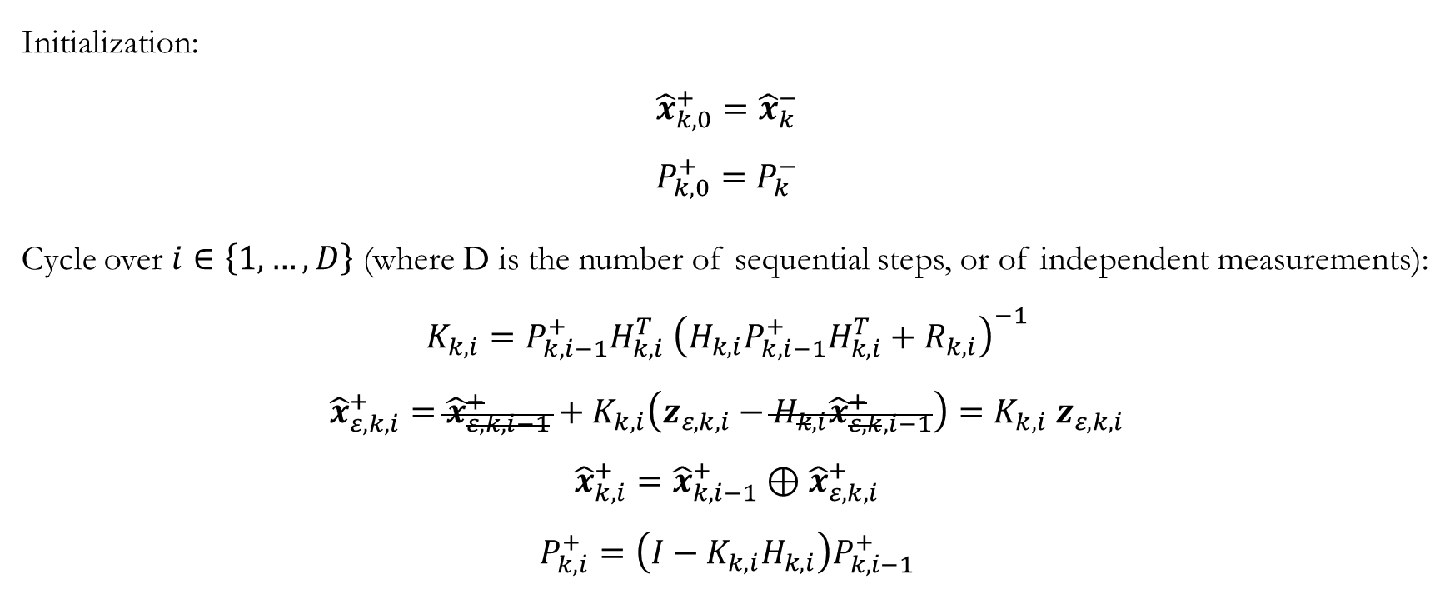
Sequential Kalman Filter Equations
Initialization:
$${\hat{x}}_{k,0}^{+}={\hat{x}}_{k}^{−}$$
$$P_{k,0}^{+}=P_{k}^{−}$$
Cycle over $i∈\left\{1,…,D\right\}$ (where D is the number of sequential steps, or of independent measurements):
$$K_{k,i}=P_{k,i−1}^{+}H_{k,i}^{T} {\left(H_{k,i}P_{k,i−1}^{+}H_{k,i}^{T}+R_{k,i}\right)}^{−1}$$
$${\hat{x}}_{ε,k,i}^{+}={\hat{x}}_{ε,k,i−1}^{+}+K_{k,i}\left(z_{ε,k,i}−H_{k,i}{\hat{x}}_{ε,k,i−1}^{+}\right)=K_{k,i} z_{ε,k,i}$$
$${\hat{x}}_{k,i}^{+}={\hat{x}}_{k,i−1}^{+}⊕{\hat{x}}_{ε,k,i}^{+}$$
$$P_{k,i}^{+}=\left(I−K_{k,i}H_{k,i}\right)P_{k,i−1}^{+}$$
Kalman Filter

Slide 41
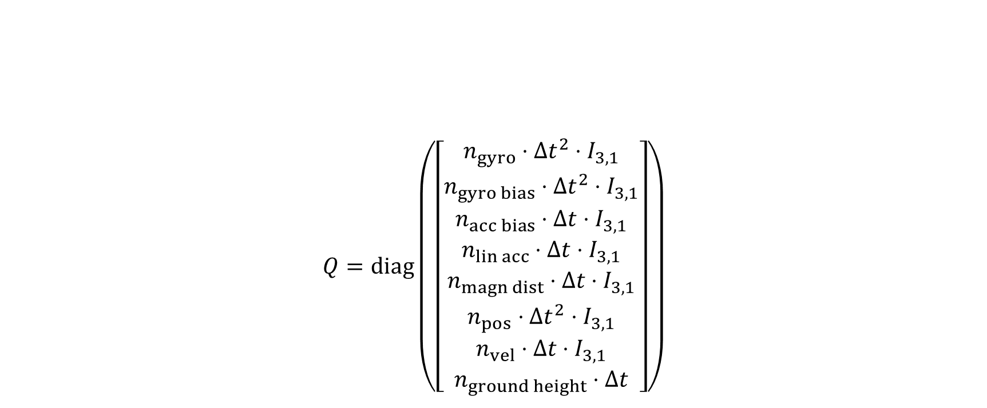
Process covariance matrix
The process covariance matrix used in the Kalman filter is diagonal.
In addition, its terms are a function of time (linear or quadratic).
$$Q=diag\left(\left[\begin{matrix}n_{gyro}⋅Δt^{2}⋅I_{3,1} \\ n_{gyro bias}⋅Δt^{2}⋅I_{3,1} \\ \begin{aligned}n_{acc bias}⋅Δt⋅I_{3,1} \\ n_{lin acc}⋅Δt⋅I_{3,1} \\ n_{magn dist}⋅Δt⋅I_{3,1} \\ n_{pos}⋅Δt^{2}⋅I_{3,1} \\ n_{vel}⋅Δt⋅I_{3,1} \\ n_{ground height}⋅Δt\end{aligned}\end{matrix}\right]\right)$$
Kalman Filter

Slide 42
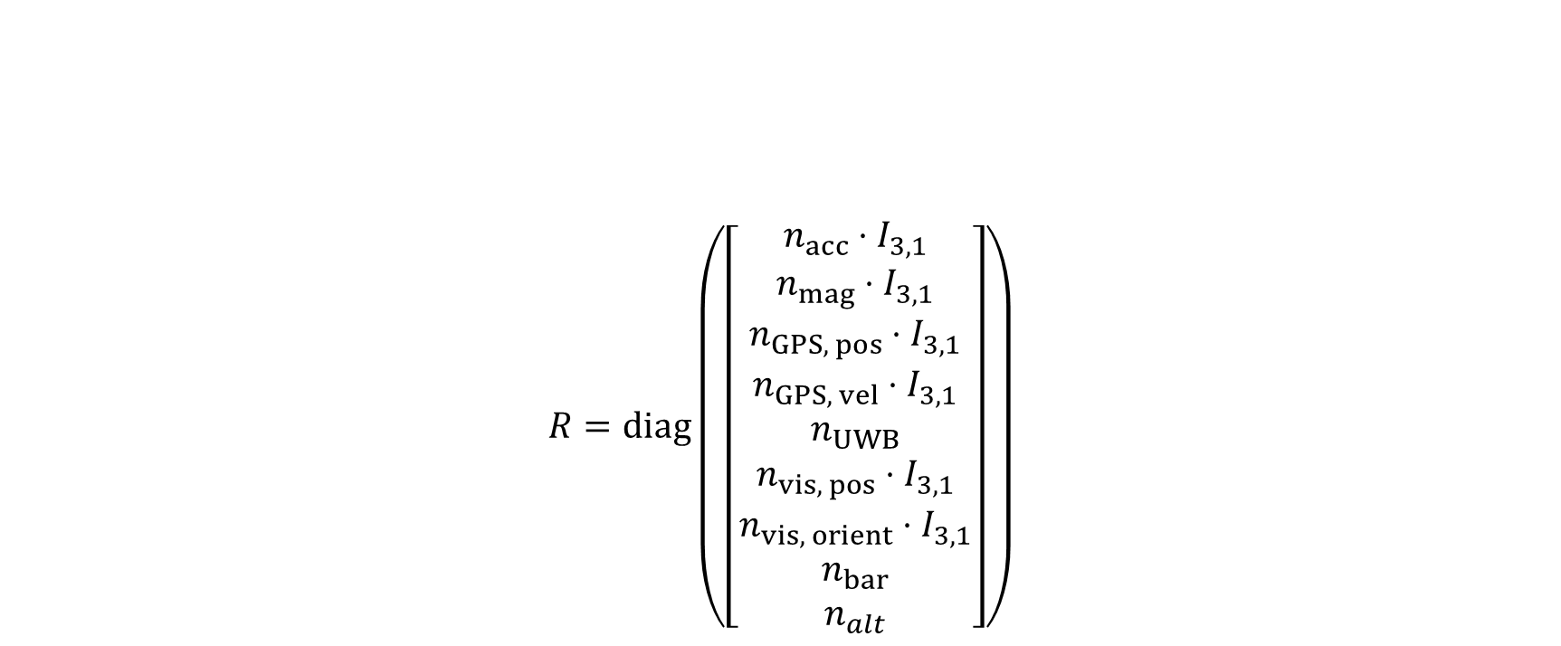
Measurement Covariance Matrix
The measurement covariance matrix used in the Kalman filter is diagonal.
This choice reflects the fact that the measurements are assumed to be uncorrelated.
$$R=diag\left(\left[\begin{matrix}n_{acc}⋅I_{3,1} \\ n_{mag}⋅I_{3,1} \\ \begin{aligned}n_{GPS, pos}⋅I_{3,1} \\ n_{GPS, vel}⋅I_{3,1} \\ n_{UWB} \\ n_{vis, pos}⋅I_{3,1} \\ n_{vis, orient}⋅I_{3,1} \\ n_{bar} \\ n_{alt}\end{aligned}\end{matrix}\right]\right)$$
Kalman Filter

Slide 43
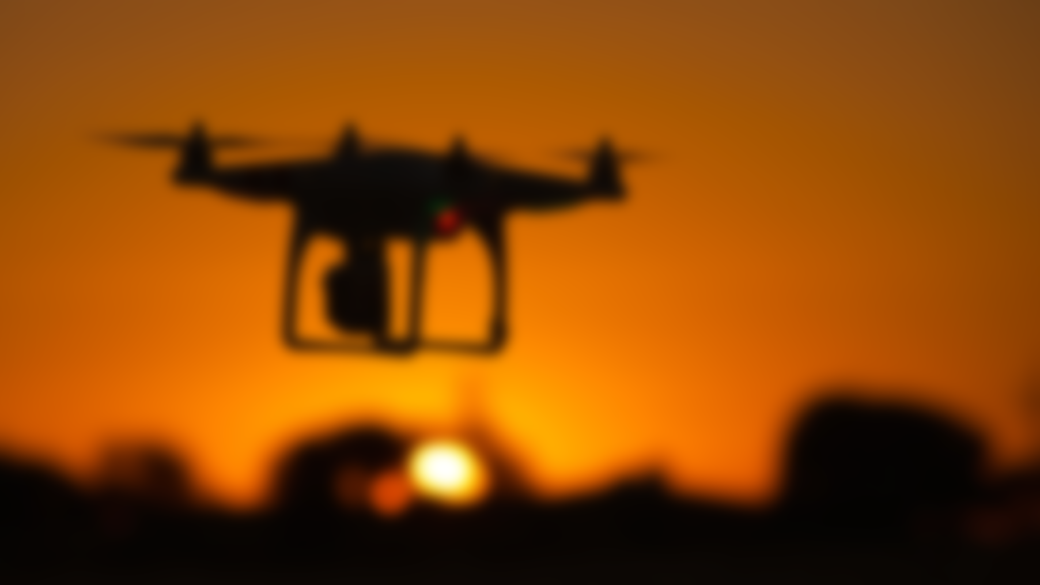
Measurement Models

Slide 44
Measurement Models
Due to the equations considered, it can be demonstrated that some measurements do not affect some states (i.e.: the magnetometer measurements do not influence the ground-height state, nor should they influence it).
Therefore, only a subset of the state and of the state covariance matrix is considered for each sensor used. This makes the filter less computationally expensive, without any loss in tracking performance.
Kalman Filter

Slide 45
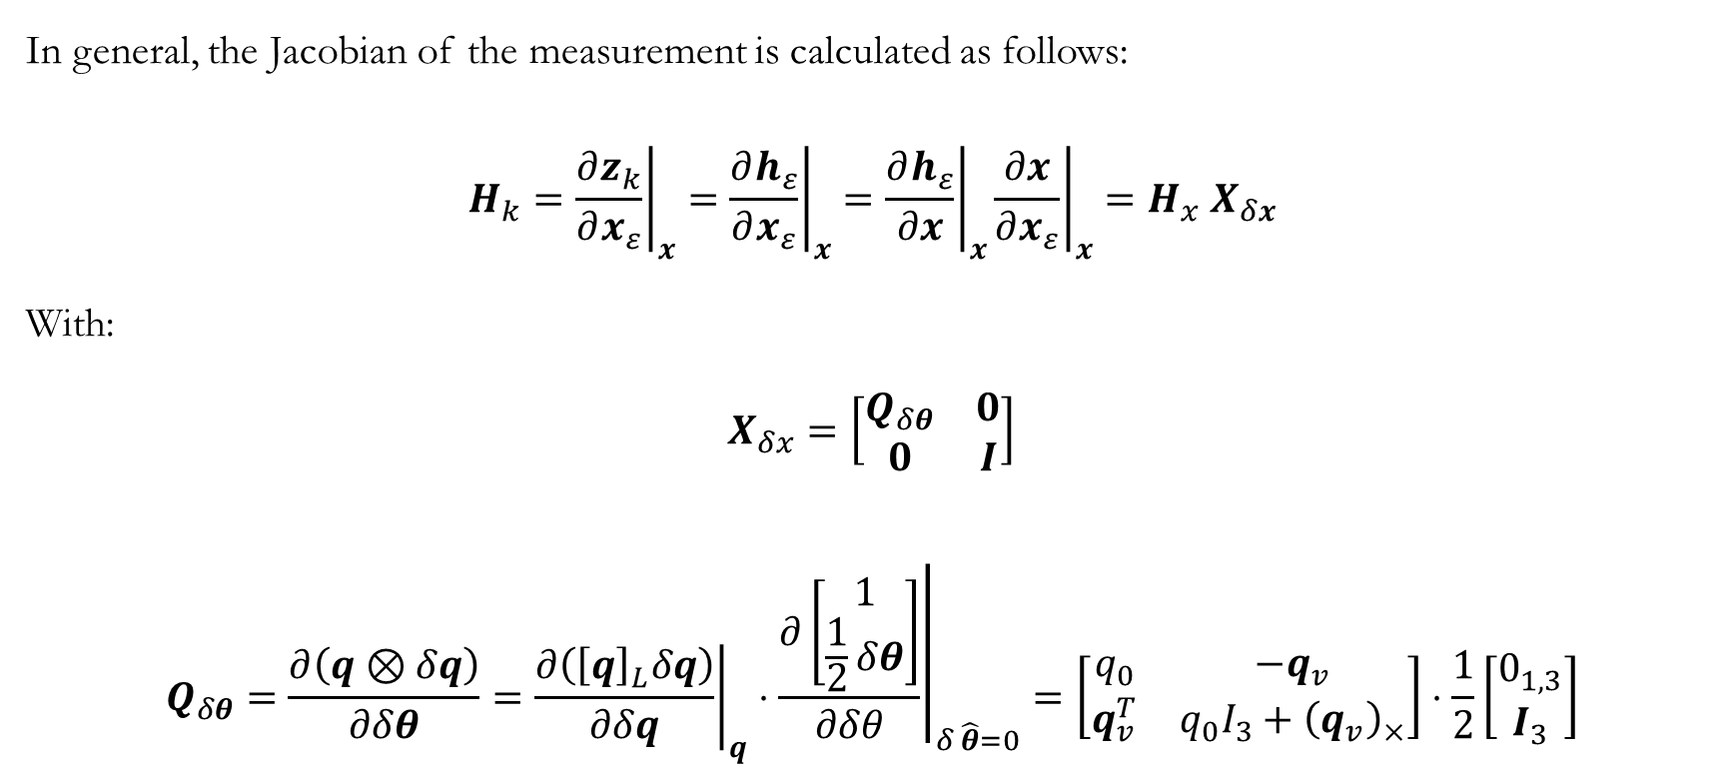
Measurement Models
In general, the Jacobian of the measurement is calculated as follows:
$$H_{k}={\left.\frac{∂z_{k}}{∂x_{ε}}\right|}_{x}={\left.\frac{∂h_{ε}}{∂x_{ε}}\right|}_{x}={\left.\frac{∂h_{ε}}{∂x}\right|}_{x}{\left.\frac{∂x}{∂x_{ε}}\right|}_{x}=H_{x}{ X}_{δx}$$
With:
$$X_{δx}=\left[\begin{matrix}Q_{δθ} & 0 \\ 0 & I\end{matrix}\right]$$
$$Q_{δθ}=\frac{∂\left(q⊗δq\right)}{∂δθ}={\left.\frac{∂\left({\left[q\right]}_{L}δq\right)}{∂δq}\right|}_{q}⋅{\left.\frac{∂\left[\begin{matrix}1 \\ \frac{1}{2}δθ\end{matrix}\right]}{∂δθ}\right|}_{δ \hat{θ}=0}=\left[\begin{matrix}q_{0} & −q_{v} \\ q_{v}^{T} & q_{0}I_{3}+{\left(q_{v}\right)}_{×}\end{matrix}\right]⋅\frac{1}{2}\left[\begin{matrix}0_{1,3} \\ I_{3}\end{matrix}\right]$$
Kalman Filter

Slide 46
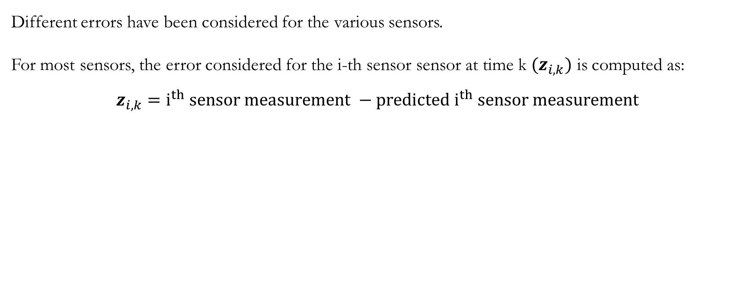
Measurement Models
Different errors have been considered for the various sensors.
For most sensors, the error considered for the i-th sensor sensor at time k ${(z}_{i,k})$ is computed as:
$$z_{i,k}=i^{th} sensor measurement −predicted i^{th} sensor measurement$$
Kalman Filter

Slide 47
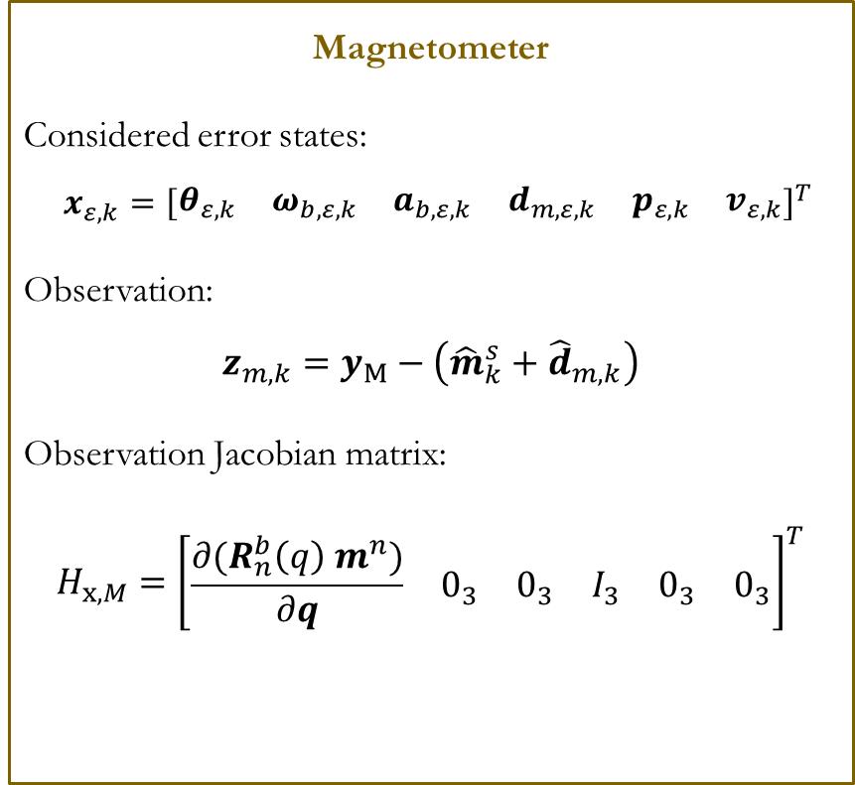
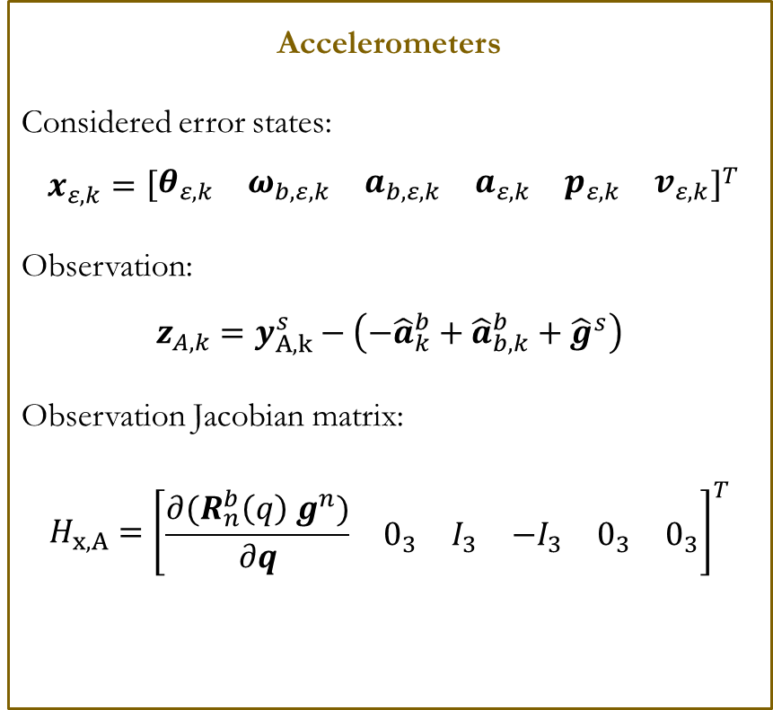
Measurement Models
Accelerometers
Considered error states:
$$x_{ε,k}={\left[\begin{matrix}θ_{ε,k} & ω_{b,ε,k} & a_{b,ε,k} & a_{ε,k} & p_{ε,k} & v_{ε,k}\end{matrix}\right]}^{T}$$
Observation:
$$z_{A,k}=y_{A,k}^{s}−\left(−{\hat{a}}_{k}^{b}+{\hat{a}}_{b,k}^{b}+{\hat{g}}^{s}\right)$$
Observation Jacobian matrix:
$$H_{x,A}={\left[\begin{matrix}\frac{∂{(R}_{n}^{b}\left(q\right) g^{n})}{∂q} & 0_{3} & I_{3} & −I_{3} & 0_{3} & 0_{3}\end{matrix}\right]}^{T}$$
Magnetometer
Considered error states:
$$x_{ε,k}={\left[\begin{matrix}θ_{ε,k} & ω_{b,ε,k} & a_{b,ε,k} & d_{m,ε,k} & p_{ε,k} & v_{ε,k}\end{matrix}\right]}^{T}$$
Observation:
$$z_{m,k}=y_{M}−\left({{\hat{m}}_{k}^{s}+\hat{d}}_{m,k}\right)$$
Observation Jacobian matrix:
$$H_{x,M}={\left[\begin{matrix}\frac{∂{(R}_{n}^{b}\left(q\right) m^{n})}{∂q} & 0_{3} & 0_{3} & I_{3} & 0_{3} & 0_{3}\end{matrix}\right]}^{T}$$
Kalman Filter

Slide 48
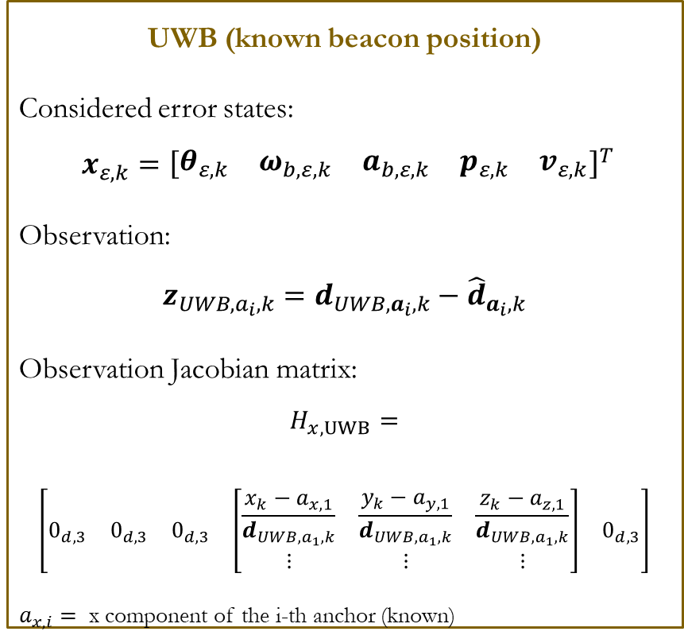
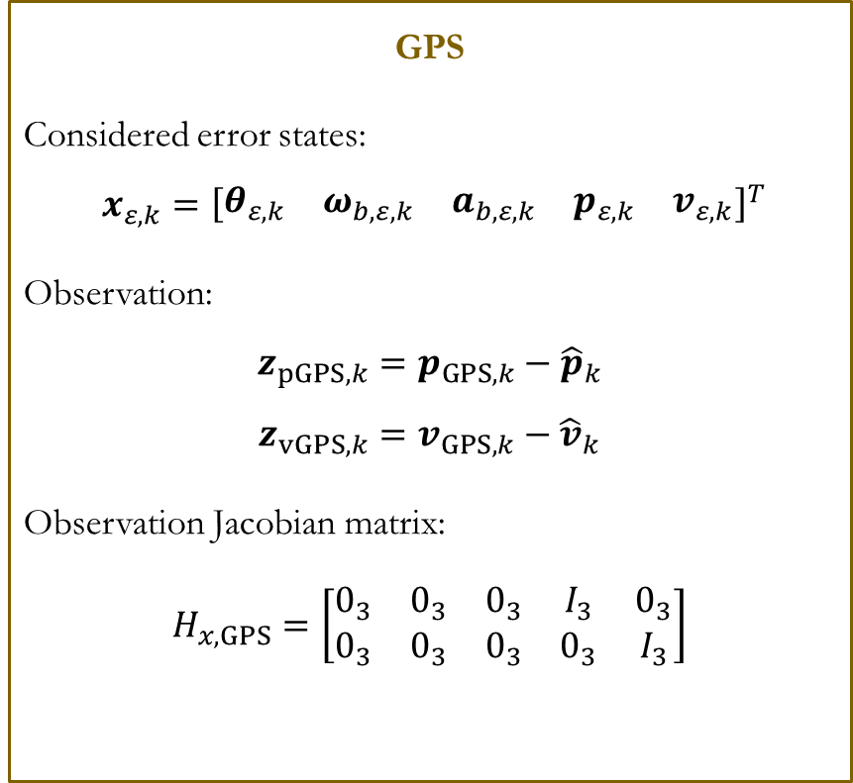
Measurement Models
GPS
Considered error states:
$$x_{ε,k}={\left[\begin{matrix}θ_{ε,k} & ω_{b,ε,k} & a_{b,ε,k} & p_{ε,k} & v_{ε,k}\end{matrix}\right]}^{T}$$
Observation:
$$z_{pGPS,k}=p_{GPS,k}−{\hat{p}}_{k}$$
$$z_{vGPS,k}=v_{GPS,k}−{\hat{v}}_{k}$$
Observation Jacobian matrix:
$$H_{x,GPS}=\left[\begin{matrix}0_{3} & 0_{3} & 0_{3} & I_{3} & 0_{3} \\ 0_{3} & 0_{3} & 0_{3} & 0_{3} & I_{3}\end{matrix}\right]$$
UWB (known beacon position)
Considered error states:
$$x_{ε,k}={\left[\begin{matrix}θ_{ε,k} & ω_{b,ε,k} & a_{b,ε,k} & p_{ε,k} & v_{ε,k}\end{matrix}\right]}^{T}$$
Observation:
$$z_{UWB,a_{i},k}=d_{UWB,a_{i},k}−{\hat{d}}_{a_{i},k}$$
Observation Jacobian matrix:
$$H_{x,UWB}=$$
$$\left[\begin{matrix}0_{d,3} & 0_{d,3} & 0_{d,3} & \left[\begin{matrix}\frac{{x_{k}−a}_{x,1}}{d_{UWB,a_{1},k}} & \frac{{y_{k}−a}_{y,1}}{d_{UWB,a_{1},k}} & \frac{z_{k}−a_{z,1}}{d_{UWB,a_{1},k}} \\ ⋮ & ⋮ & ⋮\end{matrix}\right] & 0_{d,3}\end{matrix}\right]$$
$a_{x,i}=$ x component of the i-th anchor (known)
Vector of distances measured by the anchors
Vector of distances predicted with the nominal state
Kalman Filter

Slide 49
Measurement Models
Unknown UWB
Two different methods are used when dealing with UWB beacons with unknown position:
fuse_unkn_uwb: the Kalman filter estimates both the drone states and sensor biases AND the beacon position, simultaneously. In this case, global stability of the algorithm is not guaranteed and is heavily influenced by the initial accuracy of the relative position of the UWB anchor w.r.t. the drone at the end of the initialization phase.
detect_unkn_uwb: the Kalman filter only estimates the unknown UWB beacon position, without influencing the drone states. A total of four states are considered: the anchor position coordinates and the sum of the squares of the coordinates. This fourth state is used in order to implement a spherical constraint in the filtering algorithm, ensuring global stability.
Kalman Filter

Slide 50
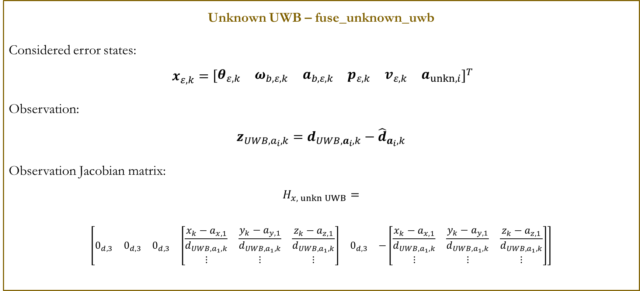
Measurement Models
Unknown UWB – fuse_unknown_uwb
Considered error states:
$$x_{ε,k}={\left[\begin{matrix}θ_{ε,k} & ω_{b,ε,k} & a_{b,ε,k} & p_{ε,k} & v_{ε,k} & a_{unkn,i}\end{matrix}\right]}^{T}$$
Observation:
$$z_{UWB,a_{i},k}=d_{UWB,a_{i},k}−{\hat{d}}_{a_{i},k}$$
Observation Jacobian matrix:
$$H_{x, unkn UWB}=$$
$$\left[\begin{matrix}0_{d,3} & 0_{d,3} & 0_{d,3} & \left[\begin{matrix}\frac{{x_{k}−a}_{x,1}}{d_{UWB,a_{1},k}} & \frac{{y_{k}−a}_{y,1}}{d_{UWB,a_{1},k}} & \frac{z_{k}−a_{z,1}}{d_{UWB,a_{1},k}} \\ ⋮ & ⋮ & ⋮\end{matrix}\right] & 0_{d,3} & −\left[\begin{matrix}\frac{{x_{k}−a}_{x,1}}{d_{UWB,a_{1},k}} & \frac{{y_{k}−a}_{y,1}}{d_{UWB,a_{1},k}} & \frac{z_{k}−a_{z,1}}{d_{UWB,a_{1},k}} \\ ⋮ & ⋮ & ⋮\end{matrix}\right]\end{matrix}\right]$$
Additional states representing the unkn anchor coordinates in nav frame
Kalman Filter

Slide 51
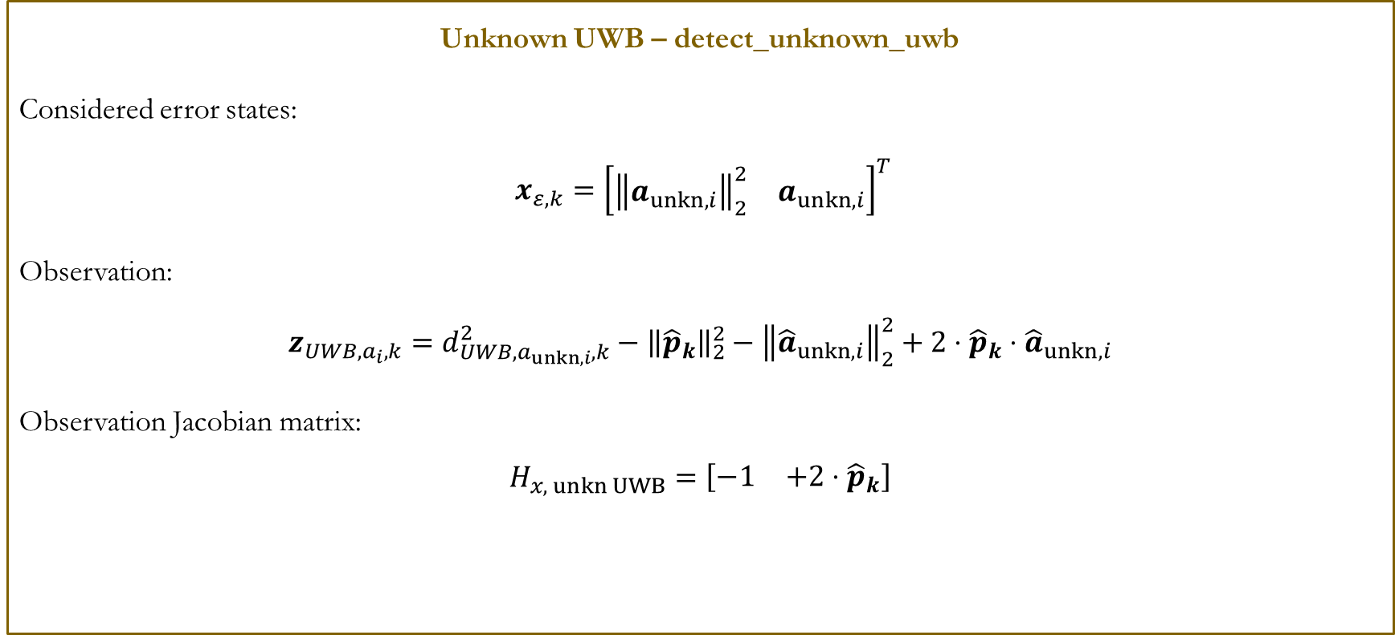
Measurement Models
Unknown UWB – detect_unknown_uwb
Considered error states:
$$x_{ε,k}={\left[\begin{matrix}{\left\|a_{unkn,i}\right\|}_{2}^{2} & a_{unkn,i}\end{matrix}\right]}^{T}$$
Observation:
$$z_{UWB,a_{i},k}=d_{UWB,a_{unkn,i},k}^{2}−{\left\|{\hat{p}}_{k}\right\|}_{2}^{2}−{\left\|{\hat{a}}_{unkn,i}\right\|}_{2}^{2}+2⋅{\hat{p}}_{k}⋅{\hat{a}}_{unkn,i}$$
Observation Jacobian matrix:
$$H_{x, unkn UWB}=\left[\begin{matrix}−1 & +2⋅{\hat{p}}_{k}\end{matrix}\right]$$
Kalman Filter

Slide 52
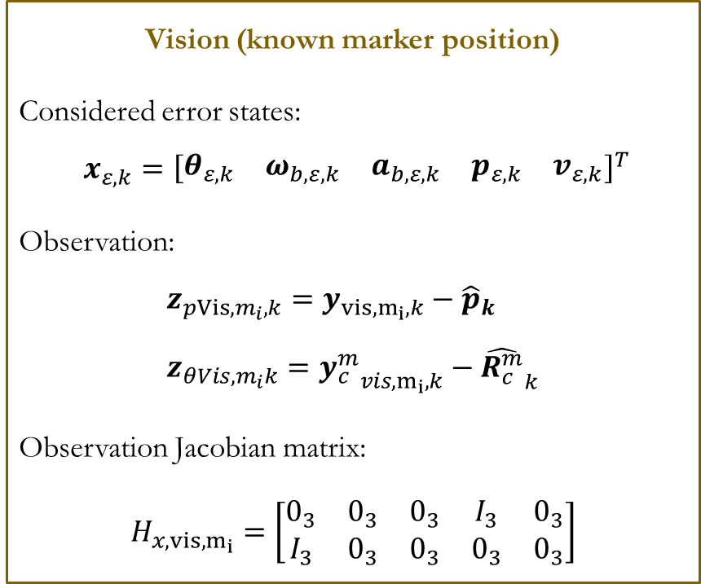
Measurement Models
Vision (known marker position)
Considered error states:
$$x_{ε,k}={\left[\begin{matrix}θ_{ε,k} & ω_{b,ε,k} & a_{b,ε,k} & p_{ε,k} & v_{ε,k}\end{matrix}\right]}^{T}$$
Observation:
$$z_{pVis,m_{i},k}=y_{vis,m_{i},k}−{\hat{p}}_{k} \\ z_{θVis,m_{i}k}={y_{c}^{m}}_{vis,m_{i},k}−{\hat{R_{c}^{m}}}_{k}$$
Observation Jacobian matrix:
$$H_{x,vis,m_{i}}=\left[\begin{matrix}0_{3} & 0_{3} & 0_{3} & I_{3} & 0_{3} \\ I_{3} & 0_{3} & 0_{3} & 0_{3} & 0_{3}\end{matrix}\right]$$
Kalman Filter

Slide 53
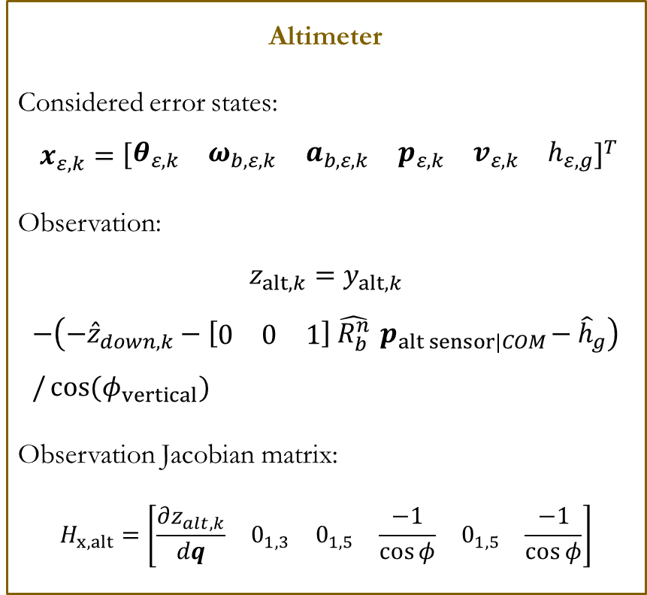
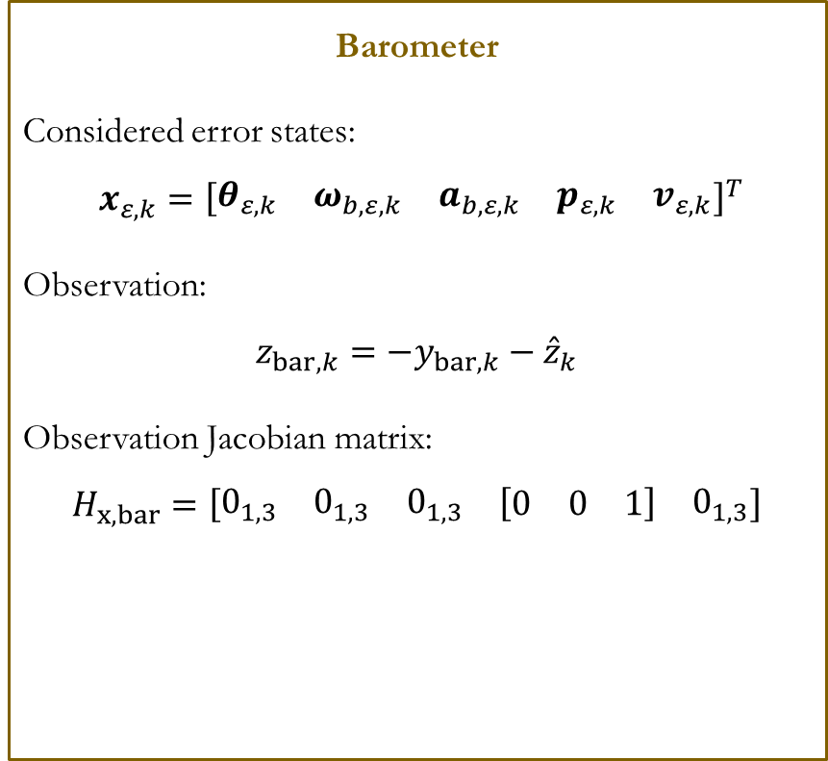
Measurement Models
Barometer
Considered error states:
$$x_{ε,k}={\left[\begin{matrix}θ_{ε,k} & ω_{b,ε,k} & a_{b,ε,k} & p_{ε,k} & v_{ε,k}\end{matrix}\right]}^{T}$$
Observation:
$$z_{bar,k}={−y}_{bar,k}−{\hat{z}}_{k}$$
Observation Jacobian matrix:
$$H_{x,bar}=\left[\begin{matrix}0_{1,3} & 0_{1,3} & 0_{1,3} & [\begin{matrix}0 & 0 & 1\end{matrix}] & 0_{1,3}\end{matrix}\right]$$
Altimeter
Considered error states:
$$x_{ε,k}={\left[\begin{matrix}θ_{ε,k} & ω_{b,ε,k} & a_{b,ε,k} & p_{ε,k} & v_{ε,k} & h_{ε,g}\end{matrix}\right]}^{T}$$
Observation:
$$z_{alt,k}=y_{alt,k}$$
$$−\left({−\hat{z}}_{down,k}−\left[\begin{matrix}0 & 0 & 1\end{matrix}\right] \hat{R_{b}^{n}}{ p}_{alt sensor|COM}−{\hat{h}}_{g}\right)/\cos{{(φ}_{vertical})}$$
Observation Jacobian matrix:
$$H_{x,alt}=\left[\begin{matrix}\frac{∂z_{alt,k}}{dq} & 0_{1,3} & 0_{1,5} & \frac{−1}{\cos{φ}} & 0_{1,5} & \frac{−1}{\cos{φ}}\end{matrix}\right]$$
Kalman Filter

Slide 54
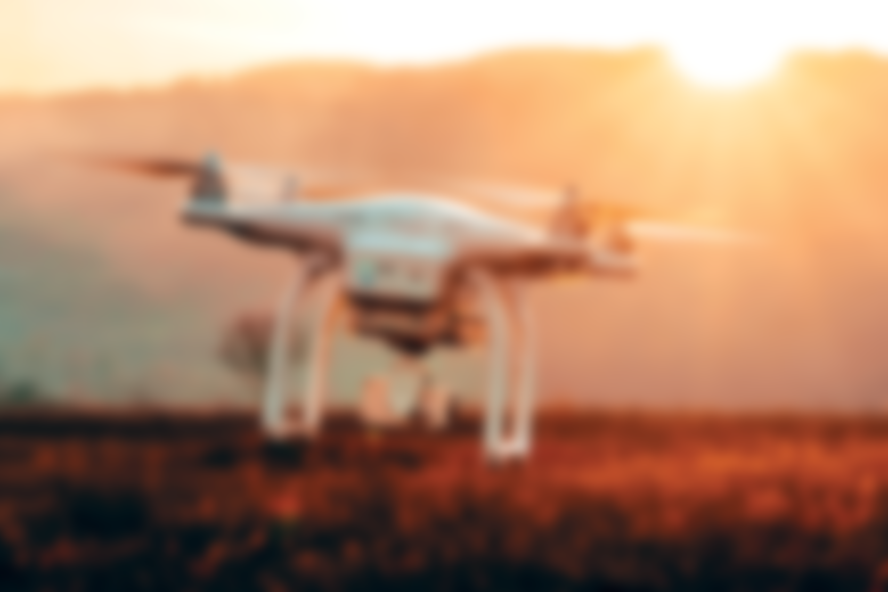
Adaptive Kalman Filtering

Slide 55
Adaptively-Robust Filter
Adaptive Kalman Filter
The adaptiveness in Kalman filtering is the ability to resist to errors in the process model.
Three main methods are used to achieve adaptiveness in the scientific literature:
Multiple Model-based Adaptive Estimation (MMAE), characterised by an very high computational cost and the necessity to model every condition of interest
Innovation-based Adaptive Estimation (IAE) with moderate computational cost and memory burden.
Adaptive factor based, with a small computational cost.
Kalman Filter

Slide 56
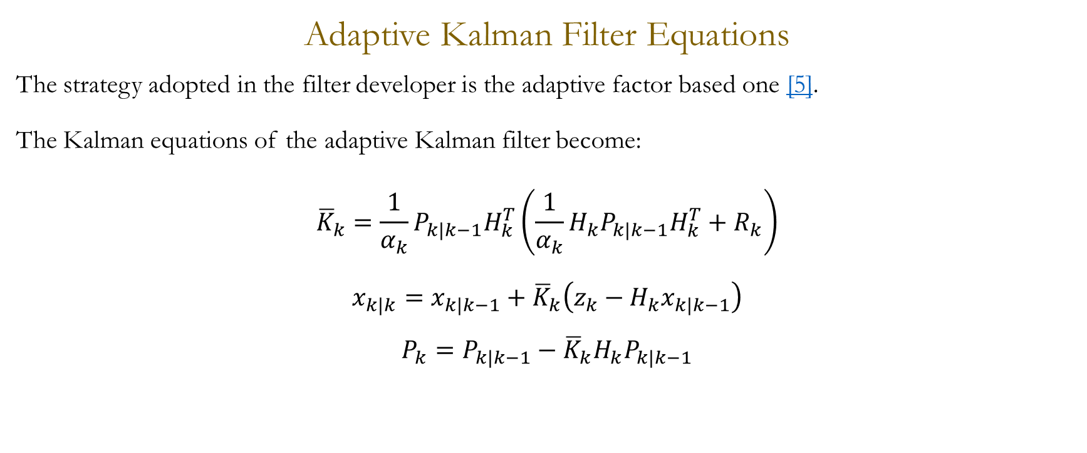




Adaptively-Robust Filter
Adaptive Kalman Filter Equations
The strategy adopted in the filter developer is the adaptive factor based one [5].
The Kalman equations of the adaptive Kalman filter become:
$${\overline{K}}_{k}=\frac{1}{α_{k}}P_{k|k−1}H_{k}^{T}\left(\frac{1}{α_{k}}H_{k}P_{k|k−1}H_{k}^{T}+R_{k}\right)$$
$$x_{k|k}=x_{k|k−1}+{\overline{K}}_{k}\left(z_{k}−H_{k}x_{k|k−1}\right)$$
$$P_{k}=P_{k|k−1}−{\overline{K}}_{k}H_{k}P_{k|k−1}$$
Kalman Filter

Slide 57
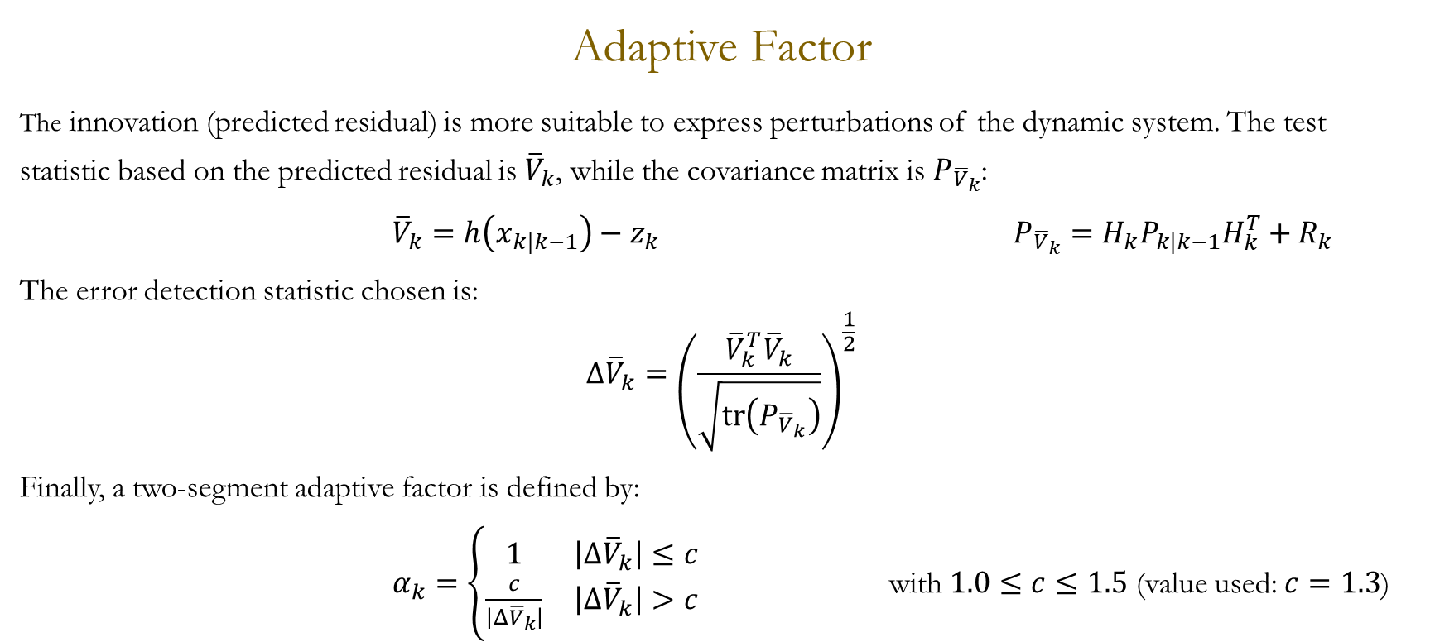
Adaptively-Robust Filter
Adaptive Factor
The innovation (predicted residual) is more suitable to express perturbations of the dynamic system. The test statistic based on the predicted residual is ${\overline{V}}_{k}$, while the covariance matrix is $P_{{\overline{V}}_{k}}$:
${\overline{V}}_{k}=h\left(x_{k|k−1}\right)−z_{k}$ $P_{{\overline{V}}_{k}}=H_{k}P_{k|k−1}H_{k}^{T}+R_{k}$
The error detection statistic chosen is:
$$Δ{\overline{V}}_{k}={\left(\frac{{\overline{V}}_{k}^{T}{\overline{V}}_{k}}{\sqrt{tr\left(P_{{\overline{V}}_{k}}\right)}}\right)}^{\frac{1}{2}}$$
Finally, a two-segment adaptive factor is defined by:
$α_{k}=\left\{\begin{matrix}1 & \left|Δ{\overline{V}}_{k}\right|≤c \\ \frac{c}{\left|Δ{\overline{V}}_{k}\right|} & \left|Δ{\overline{V}}_{k}\right|>c\end{matrix}\right.$ with $1.0≤c≤1.5$ (value used: $c=1.3$)
Kalman Filter

Slide 58
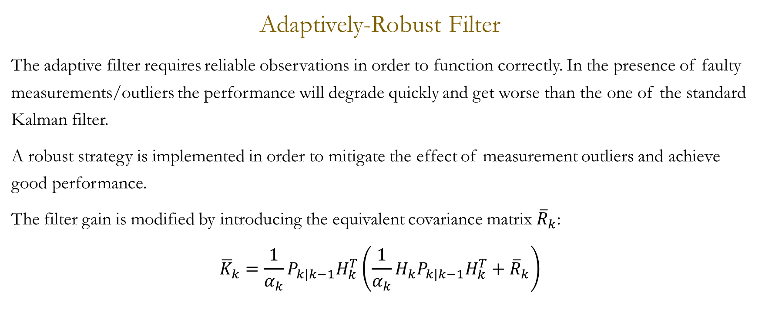

Adaptively-Robust Filter
Adaptively-Robust Filter
The adaptive filter requires reliable observations in order to function correctly. In the presence of faulty measurements/outliers the performance will degrade quickly and get worse than the one of the standard Kalman filter.
A robust strategy is implemented in order to mitigate the effect of measurement outliers and achieve good performance.
The filter gain is modified by introducing the equivalent covariance matrix ${\overline{R}}_{k}$:
$${\overline{K}}_{k}=\frac{1}{α_{k}}P_{k|k−1}H_{k}^{T}\left(\frac{1}{α_{k}}H_{k}P_{k|k−1}H_{k}^{T}+{\overline{R}}_{k}\right)$$
Kalman Filter

Slide 59
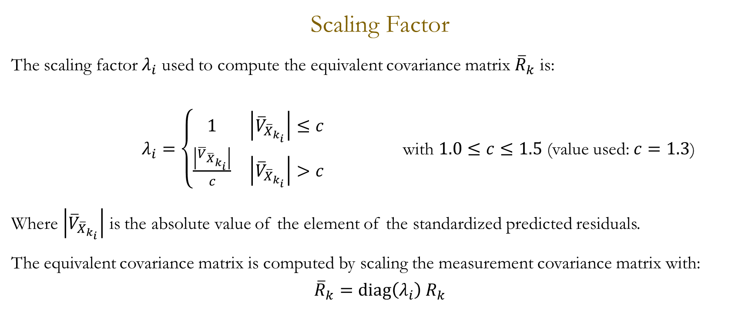
Adaptively-Robust Filter
Scaling Factor
The scaling factor $λ_{i}$ used to compute the equivalent covariance matrix ${\overline{R}}_{k}$ is:
$λ_{i}=\left\{\begin{matrix}1 & \left|{\overline{V}}_{{\overline{X}}_{k_{i}}}\right|≤c \\ \frac{\left|{\overline{V}}_{{\overline{X}}_{k_{i}}}\right|}{c} & \left|{\overline{V}}_{{\overline{X}}_{k_{i}}}\right|>c\end{matrix}\right.$ with $1.0≤c≤1.5$ (value used: $c=1.3$)
Where $\left|{\overline{V}}_{{\overline{X}}_{k_{i}}}\right|$ is the absolute value of the element of the standardized predicted residuals.
The equivalent covariance matrix is computed by scaling the measurement covariance matrix with:
$${\overline{R}}_{k}=diag\left(λ_{i}\right) R_{k}$$
Kalman Filter

Slide 60

Adaptively-Robust Filter
Mahalanobis Distance as a Statistical Test
The Mahalanobis distance $M_{k}^{2}$ is :
$$M_{k}^{2}={\left(z_{k}−{\overline{z}}_{k}\right)}^{T}{\left(P_{{\overline{z}}_{k}}\right)}^{−1}\left(z_{k}−{\overline{z}}_{k}\right)$$
With Gaussian distributed measurements, the square of the Mahalanobis distance should be Chi-square distributed with degree of freedom $r$ (dimension of the observation vector). This fact is used in order to perform a hypothesis testing to determine whether the measurement is an outlier/faulty measurement or not.
An appropriate confidence level $α$ is chosen to compute the $α$-quantile of the Chi-squared distrubition with $r$ degrees of freedom. If the square of the Mahalanobis distance is bigger than this value, the null hypothesis is rejected and the measurement is regarded as an outlier.
Kalman Filter

Slide 61

Adaptively-Robust Filter
Pseudo Code
if $M_{k}^{2}≤χ_{α}$
% The measurement is NOT regarded as an outlier => adaptive & robust filter algorithm
adaptive filter (innovation -> adaptive factor -> adaptive gain)
robust filter (scaling factor -> ${\overline{R}}_{k}$ -> robust gain)
else $M_{k}^{2}>χ_{α}$
% the measurement is regarded as an outlier => no adaptive factor
robust filter (scaling factor -> ${\overline{R}}_{k}$ -> robust gain)
end
Kalman Filter

Slide 62
Adaptively-Robust Filter
Algorithm Characteristics
Compared to other techniques (MMAE and IAE), the adaptively-robust method implemented:
Is considerably less computationally expensive.
Has smaller memory burden.
Is more sensitive in reflecting the observational errors in the present epoch (compared to both IAE windowing and forgetting factor methods).
Provides resistance to both modeling errors and measurements errors
Kalman Filter

Slide 63
Unstructured Environment Detection

Slide 64
ArUco Markers Detection
In addition to be used to aid the navigation of the drone, ArUco markers can be used to identify and localize the mission objective.
Some markers with unknown coordinates to the navigation system have been introduced. Once they are detected by the camera, a simple Kalman filter is executed to estimate their position and orientation.
The output of the Kalman filter is the estimated position and orientation in the navigation frame. This information can be used to aid the drone in completing its mission.
In the absence of other sensors such as GPS or UWB, the newly identified marker (once the estimate is reliable enough) could also be used to aid the navigation, under the hypothesis that it is fixed in the navigation frame (or that its motion is known).
Unstructured Environment Detection

Slide 65
ArUco Markers Detection
The Kalman filter used to identify the ArUco markers is implemented with the system object detect_marker:
[p_mn_n, q_mn, v_mn_n] = detect_aruco(Tcm, id, p_bn_n, q_bn)
The math behind the filter is similar to the one used to model the vision sensor. The vision sensor output and the pose of the drone in the nav. frame, are used to determine the marker position in nav. frame. This value is then filtered using a Kalman filter.
To consider the fact that the vision sensor is more accurate if the camera-marker distance is small, the measurement noise is adaptively changed and is quadratically dependent on this distance.
Unstructured Environment Detection

Slide 66
ArUco Markers Detection
This situation is interesting in the case that the mission objective (the package to be picked up) is identified by means of an ArUco marker. The position, attitude and (eventually) the velocity of the package is outputted by this separate Kalman filter. It may then be used as an input for the controller, in order to reach and pick up the package.
The velocity of the marker (and thus of the object) is not necessarly supposed to be null because, for example, the package may be located onto a moving conveyor belt. A switch has been developed for the Kalman filter so that if it is known a-priori that the package will not be moving this information is not discarded and the filter is simplified so that it does not estimate the velocity of the package too (which would decrease performance).
Unstructured Environment Detection

Slide 67

ArUco Markers Detection
ArUco Indirect Kalman Filter Matrices
States and error state:
$x_{k}={\left[\begin{matrix}q_{k} & p_{k} & v_{k}\end{matrix}\right]}^{T}$ $x_{ε,k}={\left[\begin{matrix}θ_{ε,k} & p_{ε,k} & v_{ε,k}\end{matrix}\right]}^{T}$
State transition matrix:
$$F=\left[\begin{matrix}I_{3} & 0_{3} & 0_{3} \\ 0_{3} & I_{3} & {Δt I}_{3} \\ 0_{3} & 0_{3} & I_{3}\end{matrix}\right]$$
Both the process noise covariance matrix and the measurement covariance matrix are diagonal matrices with appropriate elements.
Unstructured Environment Detection

Slide 68

ArUco Markers Detection
ArUco Indirect Kalman Filter Matrices
Observations:
$$z_{pos,k}=p_{marker}^{n}−p_{IMU}^{n}$$
$$z_{orient}=rotvec\left(q_{marker}⊗q_{IMU}^{∗}\right)$$
$$z=\left[\begin{matrix}z_{orient} \\ z_{pos,k}\end{matrix}\right]$$
Observation matrix:
$$H_{k}=\left[\begin{matrix}I_{3} & 0_{3} & 0_{3} \\ 0_{3} & I_{3} & 0_{3}\end{matrix}\right]$$
The Kalman filter equations are the same equations as the standard indirect Kalman filter written previously. Thus, they have not been written again.
Unstructured Environment Detection

Slide 69
UWB Beacons Detection
It has been supposed that some of the UWB beacons may have an unknown position in the navigation frame. This situation is interesting (mainly because of the fact that a calibration process is difficult and time consuming and not always feasible) and has already received some attention in the scientific literature.
It is possible to dynamically estimate the position of the beacons and use it to aid the navigation of the drone.
This has been done considering the fact that the current position estimate is always sufficiently accurate.
The estimation is again implemented using a standard Kalman filter.
Unstructured Environment Detection

Slide 70

UWB Beacons Detection
Before using the Kalman filter for the unknown beacon measurements, an initialization process is necessary.
This initialization is performed by acquiring a sufficient number of measurements (theoretically at least four) and solving the multilateration problem. This problem is solved with a Spherical Least-Squares estimator [9].
The particularity of this algorithm is that it estimates an additional quantity: the square of the sum of the coordinates. This is done in order to force the spherical constraint onto the LS problem:
$$\left[\begin{matrix}1 & −2x_{1} & −2y_{1} & −2z_{2} \\ ⋮ & ⋮ & ⋮ & ⋮\end{matrix}\right]\left[\begin{matrix}x^{2}+y^{2}+z^{2} \\ \begin{aligned}x \\ y\end{aligned} \\ z\end{matrix}\right]=\left[\begin{aligned}d_{1}^{2}−x_{1}^{2}−y_{1}^{2}−z_{1}^{2} \\ ⋮\end{aligned}\right]$$
$A⋅x=b$ $⇒$ $\hat{x}={\left(A^{T}A\right)}^{−1}A^{T}b$
Unstructured Environment Detection

Slide 71
UWB Beacons Detection
For the initialization, due to the low velocity of the drone, it is recommended that several data points are acquired before finishing the initialization.
A stop criterion on the initialization, used in the developed code, is based on the number of measurements acquired for each unknown beacon. Once a certain choosen threshold is reached, the initialization end. This choice is a result of the trade-off between memory requirements, computational cost, accuracy and speed of the estimation (the threshold used in the simulations is 50).
Another stop criterion could be based on the drone displacement from the first observation of the anchor. Once it has traveled (independently) a “significant” distance in all three directions, the initialization is stopped. This would be useful (to a certain degree) when dealing with “singular” trajectories (where the UWB position is not observable).
Unstructured Environment Detection

Slide 72
UWB Beacons Detection
Two methods with different characteristics have been implemented:
fuse_unknown_uwb: this algorithm is able to simultaneously estimate the position of the anchors and the state of the drone. This is implemented as seen in the previous sections. The trade-off of this implementation is that the stability is not guaranteed. The stability is highly dependent on the relative anchor position estimated during the initialization phase. Because of this, a stop criterion on the initialization phase based only on the number of data points is not enough, especially in the case of “singular” trajectories (where the UWB position is not observable). In this case, a stop criterion based on the displacement vector (not distance) could be helpful but would require other precautions in order to limit the number of data points. Instead, the second method developed may be an efficient, and iterative, solution. This implementation is based on [11].
Unstructured Environment Detection

Slide 73
UWB Beacons Detection
Two methods with different characteristics have been implemented:
detect_unknown_uwb: the spherical LS estimator equations are used to develop an iterative error-state Kalman filter. The estimated quantities are only the anchors position (no drone states). For every anchor 4 states are necessary in order to use the sperical implementation. This algorithm has the big advantage of being globally stable and able to estimate the anchor position given a non-singular trajectory. Because of this, it is the recommended solution when dealing with singular trajectories. After the anchor position has been estimated with a sufficient accuracy, the other algorithm can be used. This is an original solution based on the spherical LSE.
Unstructured Environment Detection

Slide 74
MATLAB Implementation

Slide 75
MATLAB
Software: MATLAB R2020a
Toolboxes:
Sensor Fusion and Tracking Toolbox
Mapping Toolbox
Object-oriented approach: System Objects (SO)
SO & Functions:
main
my_navigation_filter
my_navigation_filter_adaptive
uwb_sensor
aruco_vision_sensor
barometer_sensor
altimeter_sensor
Internal functions:
imuSensor
gpsSensor
HelperScrollingPlotter
PoseViewerWithSwitches
MATLAB Implementation

Slide 76
main_1
It is used to test the behaviour of the fused sensors with a real(istic) trajectory. The trajectory is loaded from a MATLAB .mat files made available by Mr MATLAB himself.
It visualizes the estimate of the pose of the drone (both position [3D] and orientation) and compares it to the real pose thanks to the poseViewerWithSwitches function.
In addition to plotting the estimated and real pose, the mentioned functions enables the user to interact with the simulation, being able to change the sensors frequencies and the currently active sensors.
A scrolling plot of the errors is visualized using the homonym function: scrolling plotter.
MATLAB Implementation

Slide 77

Interface – Pose Viewer with Switches
MATLAB Implementation

Slide 78

Interface – Scrolling Plotter
MATLAB Implementation

Slide 79
main_2
This second version of the main script is used to visualize how the drone and the navigation system behave in a partially structured environment.
Some interesting conditions are studied and the navigation system response is analyzed, evaluating its performances.
MATLAB Implementation

Slide 80
main_2 - Legend
The most important plot is a bottom view of the navigation environment:
the real trajectory is plotted with a blue, dashed, thin line
the estimated trajectory is plotted dynamically with a continuous black line (animatedline MATLAB function)
the walls of the building are represented with thick black lines
ArUco markers are represented with a square
known markers are represented in dark blue if outside the camera vision range and in green if inside
unknown markers are represented in red if outside the camera vision range and in purple if inside it
the estimate of the unknown marker position is represented in orange
MATLAB Implementation

Slide 81
main_2 - Legend
The most important plot is a bottom view of the navigation environment:
UWB beacons are represented with a circle
known beacons are represented in dark blue if they are obstructed by walls, in light blue if not obstructed but too far from the drone, and in green if their signal reaches the drone
unknown beacons are represented in red if the drone does not sense them, and in purple if they reach the drone
the estimate of the beacon position is represented in orange
MATLAB Implementation

Slide 82

main_2 - Interface
Elements:
Pose Viewer with Switches ✓
Scrolling Plotter ✓
Available sensor measurements
Top View
All internal states plot
MATLAB Implementation

Slide 83

main_2 - Interface
Elements:
Pose Viewer with Switches ✓
Scrolling Plotter ✓
Available sensor measurements
Top View
All internal states plot
MATLAB Implementation

Slide 84

main_2 - Interface
Elements:
Pose Viewer with Switches ✓
Scrolling Plotter ✓
Available sensor measurements
Top View
All internal states plot
For each plot the three colors (blue, orange and yellow) represents the three components: x, y and z.
MATLAB Implementation

Slide 85

main_2 - Interface
MATLAB Implementation

Slide 86
main_3
This version of the main script has been created in order to show the capabilities of the navigation using unknown UWB anchors.
An ad-hoc script has been created because a non-“singular” trajectory is necessary in order to use this algorithm capabilities.
A 3D interactive (can be rotated) representation of the trajectory and of the estimated trajectory is plotted in real time, showing the improvements compared to a simple dead-reckoning estimation.
MATLAB Implementation

Slide 87

main_3
MATLAB Implementation

Slide 88
my_navigation_filter
System object with the following (public) methods:
set_initial_state
predict
fuse_accel
fuse_magn
fuse_gps
fuse_uwb
fuse_unknown_uwb
detect_unknown_uwb
fuse_vis
fuse_bar
fuse_alt
private_properties_update
MATLAB Implementation

Slide 89
my_navigation_filter
To reduce the computational burden, considering the high output rate of the imu sensors and the slow dynamics of the drone, a decimation factor has been introduced. It represents the number of accelerometers measurements which are aggregated in a single measurement and used for the correction step. This guarantees a reduced computational burden (performing a Kalman filter step at the frequency of the accelerometers measurement rate is expensive) and there is no information loss.
This process is done only for the accelerometer since it is the sensor with the highest sample rate. The effect on performance may even be positive for some values of the decimation factor, since this process averages the measurements reducing the noise.
MATLAB Implementation

Slide 90

my_navigation_filter
Decimation Factor
The accelerometer measurement used for the correction step of the orientation is obtained as follows:
$$acc_{decimated,k}=\frac{1}{d}⋅\sum_{i=0}^{d−1}{Rot\left(k,i\right)⋅acc_{meas, k−i}}$$
Where $Rot\left(k,i\right)$ represents the rotation matrix from the corrected orientation at the time-step $(k−i)$ to the predicted orientation at the time-step $(k)$.
The practical iterative implementation used is the following (used to reduce memory requirements):
$$acc_{decimated}=R \left(\left(ω_{meas,k}−ω_{bias,k}\right)⋅Δt\right)⋅acc_{decimated}+\frac{1}{d}⋅acc_{meas, k}$$
This assumes that $d$ is constant. After the measurement is used in a correction step, it is reset to $0$.
MATLAB Implementation

Slide 91
my_navigation_filter
Filter Tuning
To improve the performance of the filter, two different parameters set have been used. A first set of parameters is used for the initialization phase of the filter (the initialization time has been set to be 10 seconds and the drone is supposed to stay still during this time), the second set is used for the rest of the functioning time.
The set of parameters used during the initialization phase has been tuned starting from the other set and increasing the noise on the bias terms while reducing the noise on the disturbances terms (the linear acceleration and the magnetometer disturbance). This simple trick greatly speeds up the initialization of some filter states without a loss of generality.
MATLAB Implementation

Slide 92
Simulations

Slide 93
Simulations: Scenario 1
Main Simulated Scenario
All the sensors are simulated: accelerometer, magnetometer, gyroscope, GPS, UWB, vision sensor, barometer and altimeter.
It is observed how they interact and how the filter behaves at the interface between different “zones» (when the GPS shuts down and the UWB signal starts to be received).
It is also observed the behaviour of the ground height estimation, and the detection and localization of unknown UWB beacons and ArUco markers.
Simulations

Slide 94
Simulations: Scenario 1
Simulations

Slide 95
Simulations: Scenario 1
Simulations

Slide 96

Simulations: Scenario 1
Simulations

Slide 97

Simulations: Scenario 1
Simulations

Slide 98

Simulations: Scenario 1
Simulations

Slide 99

Simulations: Scenario 1
Simulations

Slide 100

Simulations: Scenario 1
Simulations

Slide 101

Simulations: Scenario 1
Simulations

Slide 102
Simulations: Scenario 2
Secondary Simulated Scenario
No particual condition is studied in this scenario.
It only serves as an additional benchmark.
In the late parts of the trajectory, only two UWB beacons are visible simultaneously. They are thus unable to localize the drone autonomously. Nonetheless, the filter estimation accuracy is still very good.
Simulations

Slide 103

Simulations: Scenario 2
Simulations

Slide 104
Simulations: Scenario 3
Magnetometer Disturbance Simulatiton
It is studied how the system reacts to significative magnetometer disturbances.
Simulations

Slide 105

Simulations: Scenario 3
Simulations

Slide 106
Simulations: Scenario 4
Faulty GPS Measurements
The Robust estimation algorithm is put to work.
The GPS measurements are contaminated by outliers.
The behaviour of the " standard" KF is compared to the behaviour of the adaptively-robust one.
Simulations

Slide 107

Simulations: Scenario 4
Simulations

Slide 108

Simulations: Scenario 4
Simulations

Slide 109

Simulations: Scenario 4 – Non Adaptive Filter
Simulations

Slide 110

Simulations: Scenario 4 – Adaptive Filter
Simulations

Slide 111


Simulations: Scenario 4 – Non Adaptive Filter
Simulations

Slide 112

Simulations: Scenario 4 – Adaptive Filter
Simulations

Slide 113
Simulations: Scenario 5
Faulty UWB Measurements
The Robust estimation algorithm is put to work, again :o
The GPS measurements are contaminated by NLOS errors.
The behaviour of the " standard" KF is compared to the behaviour of the adaptively-robust one.
Simulations

Slide 114

Simulations: Scenario 5
Simulations

Slide 115

Simulations: Scenario 5
Simulations

Slide 116

Simulations: Scenario 5 – Non Adaptive Filter
Simulations

Slide 117

Simulations: Scenario 5 – Adaptive Filter
Simulations

Slide 118
main_3
The behaviour of fuse_unknown_uwb is studied with an appropriate trajectory (appropriate in the sense that it is not singular).
It is first showed how accurate dead-reckoning navigation is.
Then, it is compared to the performance of the SLAM algorithm.
The duration of the simulated scenario is 40 seconds.
Simulations

Slide 119


Slide 120


Slide 121
Bibliography

Slide 122
Bibliography
W. Youn and S. Andrew Gadsden, "Combined Quaternion-Based Error State Kalman Filtering and Smooth Variable Structure Filtering for Robust Attitude Estimation," in IEEE Access, vol. 7, pp. 148989-149004, 2019, doi: 10.1109/ACCESS.2019.2946609.
H. Bavle, J. L. Sanchez-Lopez, A. Rodriguez-Ramos, C. Sampedro and P. Campoy, "A flight altitude estimator for multirotor UAVs in dynamic and unstructured indoor environments," 2017 International Conference on Unmanned Aircraft Systems (ICUAS), 2017, pp. 1044-1051, https://doi.org/10.1109/ICUAS.2017.7991467
Woo, Rinara, Eun-Ju Yang, and Dae-Wha Seo. 2019. "A Fuzzy-Innovation-Based Adaptive Kalman Filter for Enhanced Vehicle Positioning in Dense Urban Environments" Sensors 19, no. 5: 1142. https://doi.org/10.3390/s19051142
Feng, Kaiqiang, Jie Li, Xiaoming Zhang, Chong Shen, Yu Bi, Tao Zheng, and Jun Liu. 2017. "A New Quaternion-Based Kalman Filter for Real-Time Attitude Estimation Using the Two-Step Geometrically-Intuitive Correction Algorithm" Sensors 17, no. 9: 2146. https://doi.org/10.3390/s17092146
Jiang, Chen, and Shu-Bi Zhang. 2018. "A Novel Adaptively-Robust Strategy Based on the Mahalanobis Distance for GPS/INS Integrated Navigation Systems" Sensors 18, no. 3: 695. https://doi.org/10.3390/s18030695
Li, Xin, Yan Wang, and Kourosh Khoshelham. 2018. "A Robust and Adaptive Complementary Kalman Filter Based on Mahalanobis Distance for Ultra Wideband/Inertial Measurement Unit Fusion Positioning" Sensors 18, no. 10: 3435. https://doi.org/10.3390/s18103435
Escamilla-Ambrosio, P. Jorge & Mort, N.. (2000). Adaptive Kalman filtering through fuzzy logic.
Bibliography

Slide 123
Bibliography
Yang Y. (2010) Adaptively Robust Kalman Filters with Applications in Navigation. In: Xu G. (eds) Sciences of Geodesy - I. Springer, Berlin, Heidelberg. https://doi.org/10.1007/978-3-642-11741-1_2
Norrdine, Abdelmoumen. (2015). An Algebraic Solution to the Multilateration Problem. https://doi.org/10.13140/RG.2.1.1681.3602
Liu, Jianfeng, Jiexin Pu, Lifan Sun, and Zishu He. 2019. "An Approach to Robust INS/UWB Integrated Positioning for Autonomous Indoor Mobile Robots" Sensors 19, no. 4: 950. https://doi.org/10.3390/s19040950
Q. Shi, S. Zhao, X. Cui, M. Lu and M. Jia, "Anchor self-localization algorithm based on UWB ranging and inertial measurements," in Tsinghua Science and Technology, vol. 24, no. 6, pp. 728-737, Dec. 2019, doi: 10.26599/TST.2018.9010102.
Xu, Shuqing, Haiyin Zhou, Jiongqi Wang, Zhangming He, and Dayi Wang. 2019. "SINS/CNS/GNSS Integrated Navigation Based on an Improved Federated Sage–Husa Adaptive Filter" Sensors 19, no. 17: 3812. https://doi.org/10.3390/s19173812
Chang, G. Robust Kalman filtering based on Mahalanobis distance as outlier judging criterion. J Geod 88, 391–401 (2014). https://doi.org/10.1007/s00190-013-0690-8
Almagbile, Ali & Wang, Jinling & Ding, Weidong. (2010). Evaluating the Performances of Adaptive Kalman Filter Methods in GPS/INS Integration. Journal of Global Positioning Systems. 9. 10.5081/jgps.9.1.33.
Bibliography

Slide 124
Bibliography
Roetenberg, Daniel & Luinge, Hendrik & Baten, Chris & Veltink, Peter. (2005). Compensation of Magnetic Disturbances Improves Inertial and Magnetic Sensing of Human Body Segment Orientation. Neural Systems and Rehabilitation Engineering, IEEE Transactions on. 13. 395 - 405. 10.1109/TNSRE.2005.847353.
Bibliography

Slide 125
THANK YOU FOR THE ATTENTION

